Slide 1
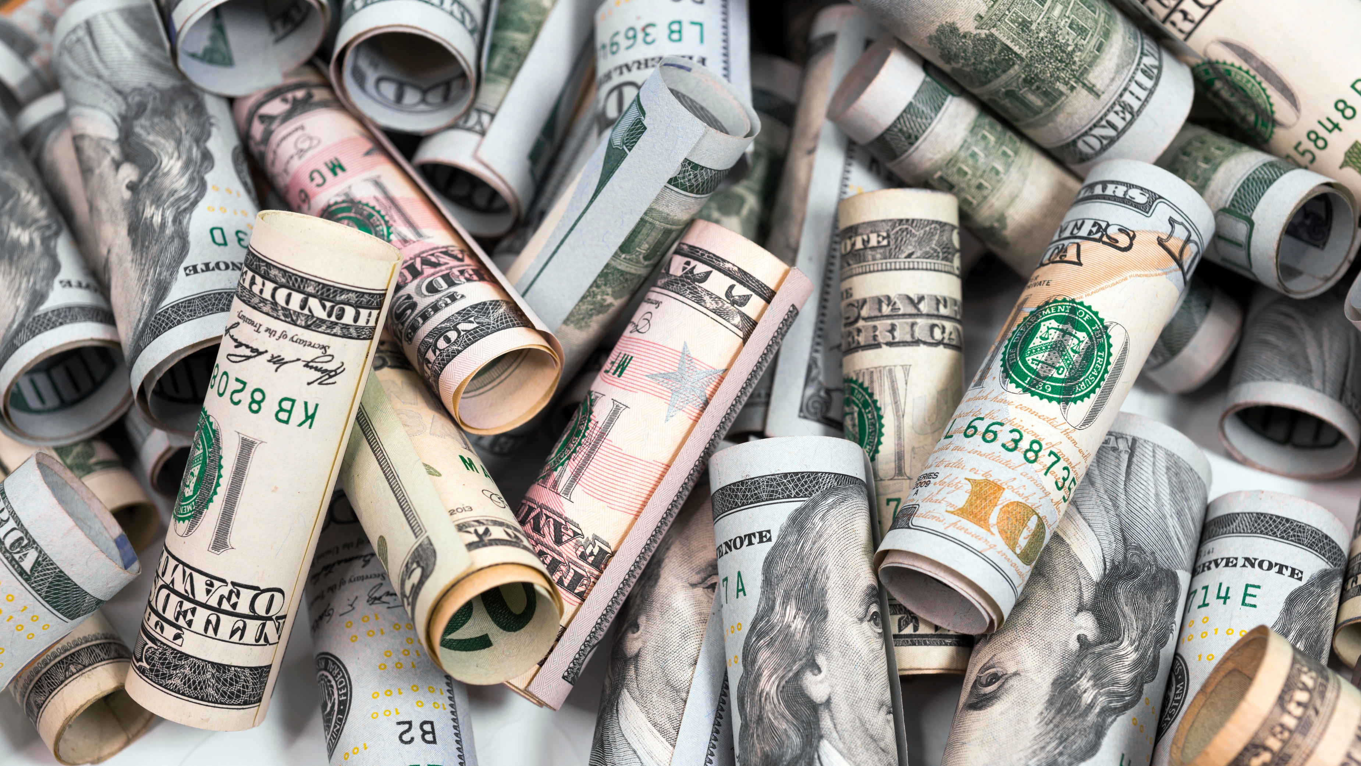
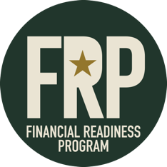
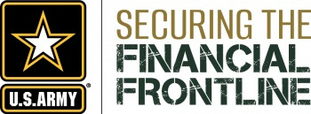
FINANCIAL READINESS PROGRAM
Consumer Awareness
Notes:
Learning Activity 7: Consumer Awareness
Method of Instruction: Classroom/Discussion
Instructor to Student Ratio: 1:25
Time of Instruction: 60 Min.
Media: Large Group Instruction
Required Student Materials:
Calculator
Pencil
INTRODUCTION: Unfortunately, a large percentage of our population doesn't see anything wrong with "exaggerated product claims," or high-pressure sales tactics. Young military members and their spouses are common targets of frauds and cons.
It is impossible to cover all of the fraud, cons, and rip-offs currently in existence, and new scams are popping up everyday. Gathering accurate statistics about the number of fraud committed is also difficult, because some people are embarrassed to admit that they've been a victim.
It is important that you, the consumer, develops a sense of awareness surrounding these issues to avoid becoming a victim yourself.

Slide 2

Objectives
01 |  | Recognize and understand how to protect yourself from misleading consumer practices & report complaints.
02 |  | Know military consumer protection law fundamentals.
03 |  | Recognize and identify steps to resolve identity theft.
Notes:
SHOW SLIDE 7-2: OBJECTIVES
During this lesson, we will cover some of the most common types of fraud, cons, and rip-offs, how marketing and advertising play a part, and look at ways that you can protect yourself from misleading consumer practices. We will go over how to report complaints and what military consumer protection laws there are. We will also explore what identity theft is, and how you can protect yourself from becoming a target.

Slide 3
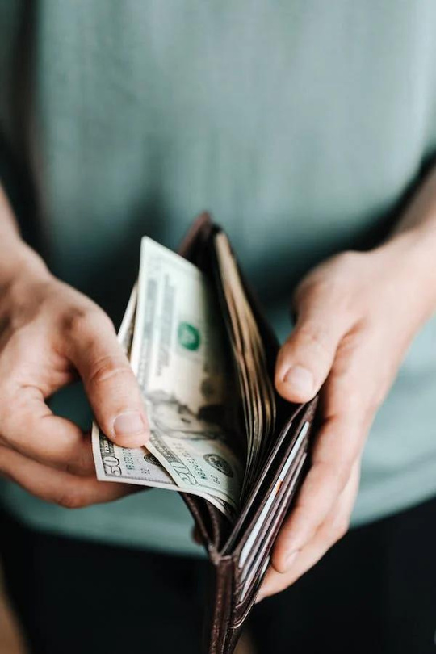
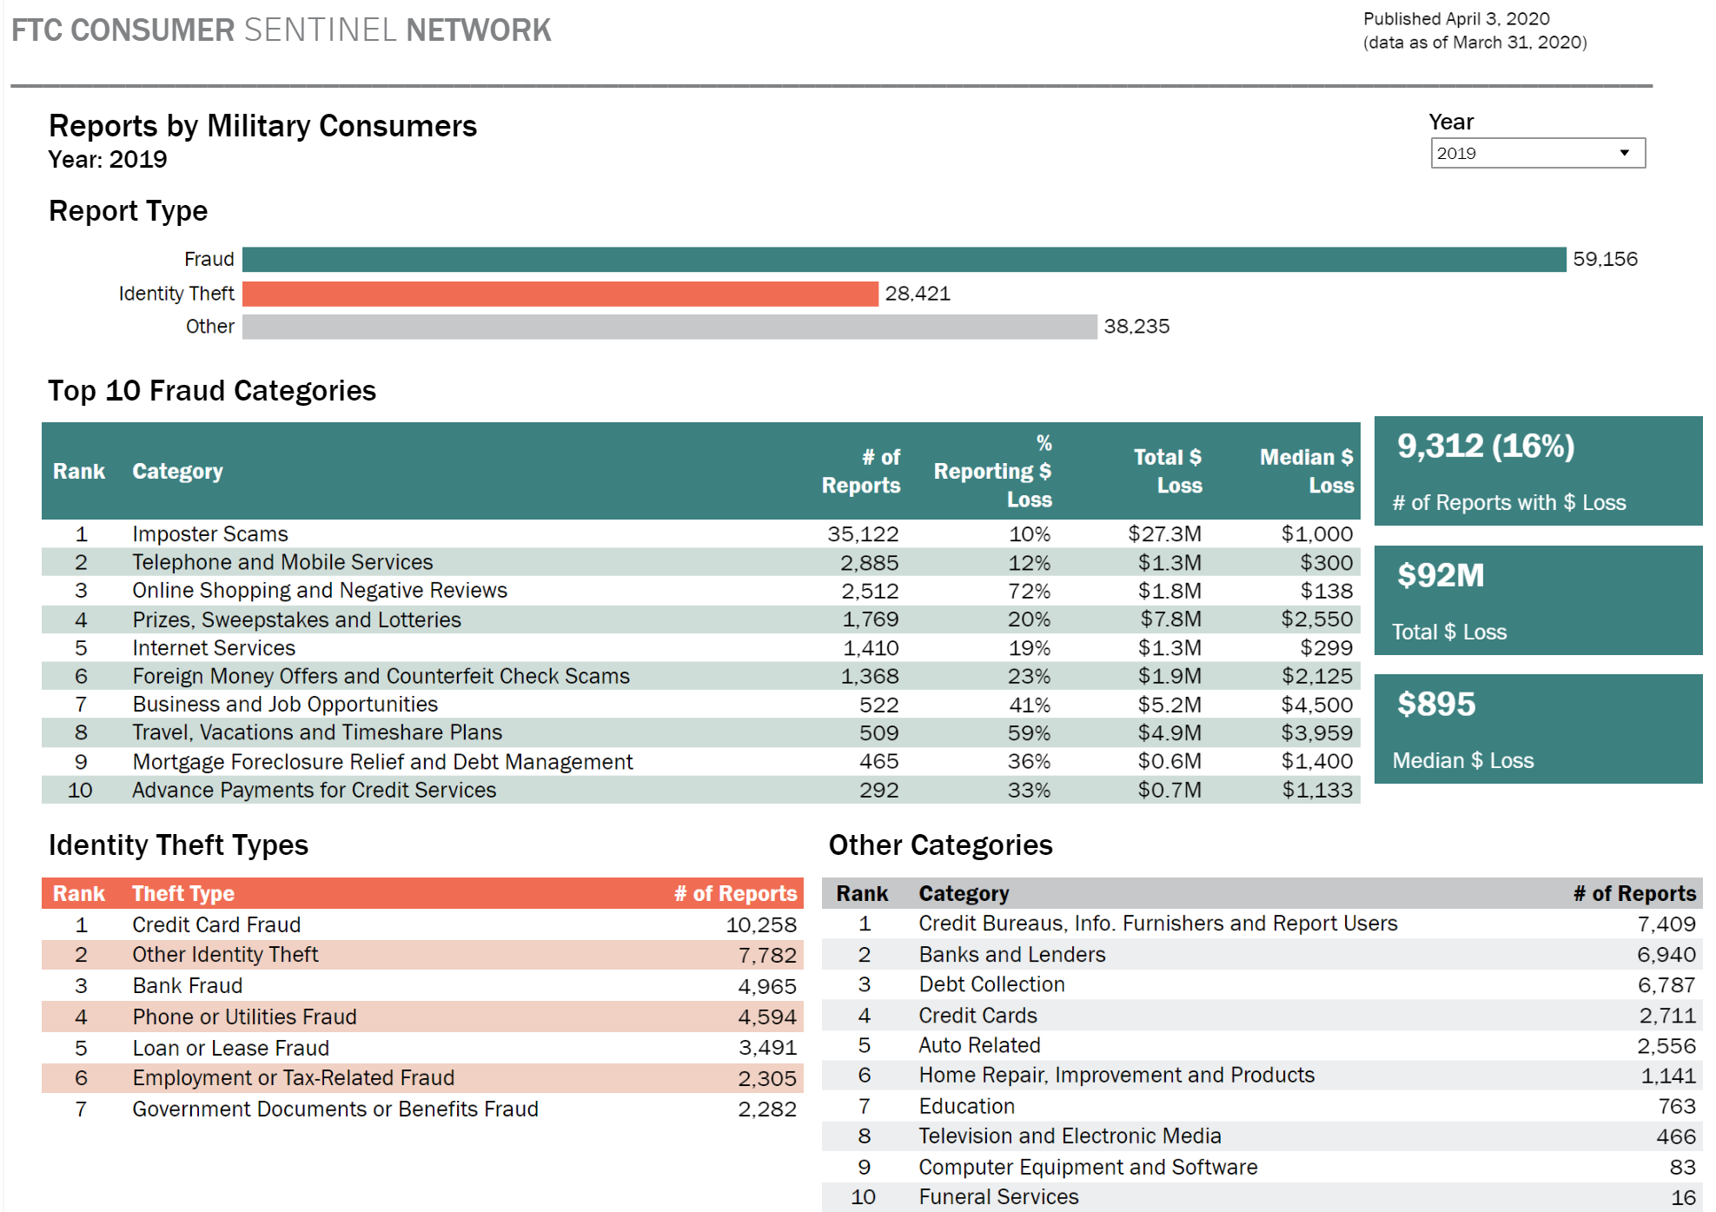
Why Does This Matter?
Notes:
SHOW SLIDE 7-3: WHY DOES THIS MATTER?
Service members, like all consumers, are potential targets for fraud. That said, certain scams are more likely to target the military community, in part because military families may relocate frequently and many serviced members – for the first time – are living on their own and earning a paycheck. Moreover, fraud against military consumers can undermine military readiness and troop morale.
According to the Federal Trade Commission Active Duty Service Members are 76% more likely than other adults to report that an identity thief misused existing accounts, such as a bank account or credit card.
Active Duty Service Members are nearly three times as likely to report that someone used a debit card or some other electronic means to take money directly from their bank account without their permission. They also are 22% more likely to report that their stolen information was misused to open a new account, especially new credit card accounts.
Reports indicate that securing personal information may present special challenges for Active Duty troops. According to the Federal Trade Commission Spotlight, nearly 14 % of Active Duty service members who reported identity theft said that a family member or someone they know misused their identity, compared to just 7% of other adults.
According to the Federal Trade Commission, in 2019, over $92 million was lost to scams, fraud, and identity theft. See https://www.ftc.gov/news-events/media-resources/military-consumer-protection for more information

Slide 4
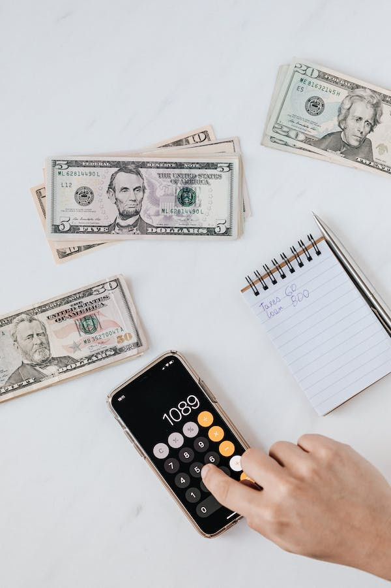
Defining Deception
. Fraud - A deliberate deception
Intended for financial gain
Con - Requires winning a victim’s CONfidence
Persuading or tricking
Rip-Off An unfair act of exploitation, not necessarily illegal No consumer protection
Notes:
SHOW SLIDE 7-4 DEFINING DECEPTION
Now that you have a little knowledge about how people influence you, let's look at some of the techniques they use. You've seen them everywhere -- people trying to convince you that you must have or need something. There are a number of ways that they can convince you of those needs.
Here are the most common types of misrepresentations.
Fraud - Fraud is a deliberate deception. It is intentional and usually relies on a twisting of the facts. For example, individuals who convince others they are someone they really aren’t, are frauds.
Con - A con is similar to fraud except that the manipulator, or con artist, first wins the CONfidence of the person being defrauded. They convince the unwitting person that they are a friend, and as such, they have their best interests in mind.
Rip-Off - Rip-off’s are unfair acts of exploitation, but they are not necessarily illegal. Rip-off’s take advantage of areas where there are no consumer laws to provide protection.
Remember, the bottom line for all of these scams is to separate you from your money.

Slide 5
Why Are Soldiers Targets?
Guaranteed pay
Pay is public knowledge
Garnishments
Security Clearances must be upheld
Frequently change personal data
Deployments
Relocate frequently
Knowledge of things that are of interest to adversaries
Notes:
SHOW SLIDE 7-5: WHY ARE SOLDIERS TARGETS?
Soldiers are targets for consumer predators, as they have economically attractive qualities. Service members may be at a higher risk because scammers know they have guaranteed government paychecks and frequently changing personal data. Temporary addresses, deployments and an often-transient lifestyle make service members especially reliant on digital communication --- even for important subjects. Unfortunately, this reliance and trust can also make them more vulnerable to identity theft and fraud.
Service members have a steady paycheck and little danger of being laid off.
-ͧͧMany service members are young adults who are away from home for the first time and eager to experience new things.
ͧͧ-Businesses are aware of the ease of paying by allotment and know procedures to garnish a military paycheck.
-ͧͧService members may have greater financial needs, with multiple deployments, frequent PCSs, and families.
-ͧͧMilitary conduct codes that stress the need for orderly personal lives, including orderly finances, may inadvertently drive service members toward quick fixes offered by consumer predators.
-ͧͧService members are an easy population for debt collectors to track.
-ͧͧService members are easy to identify even in civilian clothes. It is easy for salespeople who have experienced military life to engage them, appear authoritative, and use that advantage to sell them something.
-ͧͧPeriods of deployment uniquely affect service members and their families. Service members often spend the money they have saved during deployments on big-ticket items (e.g., cars, motorcycles, game systems) because they have “money burning a hole in their pocket.”

Slide 6
01
Informative
The Psychology of Advertising
02
Emotional
03
Personalization Association
04
Buzz Words
05
Fear
06
Berating
Notes:
SHOW SLIDE 7-6: THE PSYCHOLOGY OF ADVERTISING
To better understand how a person becomes susceptible to being scammed, you must first be able to recognize the psychology being used on the consumer. One of the most prevalent areas psychological tactics are used to scam consumers is in advertising.
Let's look at a few ways that advertising and marketing can influence the decisions you make.
Types of Advertising - The goal of advertising is to get you to buy a product or service, to buy more than you planned to buy, to spend more than you intended to spend, and, if possible, to get you to buy something that you did not want or need in the first place. There are several common types of advertising.
(1) Personalized - Designed to make the individual think that the salesman or advertiser wants him or her, personally, for a customer. May include 'personalized' junk mail or phone calls. Preys on the idea that we all want to have friends, and here is one - if you buy their product.
(2) Association - Uses familiar people from the entertainment and sports industry to sell the product. The idea is that you can associate with or relate to that person on a personal level if you buy the product they endorse.
(3) Buzz Words - Words and phrases created to catch your attention and make you think the product is somehow special or better than the competition's version. The idea is to make you want to get rid of the other stuff and buy this one in order to have the newest, latest, best. This is often called "baiting a sale". Examples include "Clearance," "Sale," "Closeout," and "Liquidation.“
(4) Fear - Part of the emotional appeal approach. Plays on your fear of rejection or loss if you don't use the favored product. This often includes the idea of personal ruin if this product is not used or purchased.
(5) Berating (Put Down) - The goal is to convince you that something is wrong with you if you don't buy their products.

Slide 7
01
Auto Repair Rip-Offs
The Scoop on Scams
02
Bait & Switch
03
Investment Schemes
04
Prize Promotions
05
Questionable Charities
06
Credit Repair
Notes:
SHOW SLIDE 7-7: SCOOP ON SCAMS
There are many ways unwitting people become targets of dishonest dealings.
Here are some of the most common scams that you should be aware of.
We will now discuss each of these scams in further detail.

Slide 8
01
Misdiagnosis
Auto Repair Rip-Offs
02
Lesser Quality Parts
03
Overcharging 10% Rule
Women and Seniors are targeted
04
Notes:
SHOW SLIDE 7-8: AUTO REPAIR RIP-OFFS
Auto repair rip-offs consistently rank as the number one consumer complaint throughout the nation.
Common dishonest practices you may see with auto repair:
Misdiagnosing -- telling you a major repair is needed when only a minor one will do.
Installation of a lesser quality part than what you were charged for. Request to see your old part. A "rebuilt" part should look new. A dirty or rusty part may have been "salvaged" from a junkyard for about 10% of the cost of a rebuilt or refurbished part.
Be aware that most states have laws that require auto repair facilities to give you a written estimate of what their work will cost. If they exceed the written estimate by more than 10% without your permission, you are not required to pay.

Slide 9
Bait & Switch
Read the fine print!
If it seems too good to be true it probably is!
Notes:
SHOW SLIDE 7-9: BAIT AND SWITCH
In this ruse, stores advertise fabulous bargains just to get you in the door, and then try to sell you a more expensive product.
Often, the advertised item is not available for several reasons: there aren't any left. . . you can't get delivery for six months, etc.
If you encounter a "bait and switch", leave immediately.
IF IT SEEMS TOO GOOD TO BE TRUE, IT PROBABLY IS.

Slide 10
Investment Schemes
What is a Ponzi Scheme/Pyramid Scheme?
  It is a fraudulent investment operation where earlier investors ae paid with funds given by subsequent investors.
Red Flags:
  “High Rate of Return, very low risk!” (doesn’t exist)
  “I’ve got ‘insider info’” (this is illegal)
Notes:
SHOW SLIDE 7-10: INVESTMENT SCHEMES
Investment schemes promise high rates of return with minimal risk.
The most known investment scheme is the Ponzi, or Pyramid Scheme. This is when money from new investors is used to provide a return to previous investors. The problem becomes when the money owed to the investors is greater than the money that can be raised from new ones. These schemes always eventually collapse.
Promoters of investment schemes often operate a particular scam for a short time, quickly spend the money they take in, then close before they can be detected.
In their sales pitch, they'll say that they have high-level financial connections; that they're privy to inside information; that they'll guarantee the investment; or that they'll buy back the investment after a certain time. They will tell you that the investment has a very high rate of return, very low risk. This type of investment doesn’t exist.
To close the deal, they often serve up phony statistics, misrepresent the significance of a current event, or stress the unique quality of their offering.
These schemes are a good investment for the promoters, but not for the participants.

Slide 11
Charity Fraud
Using deception to get money out of people who believe they are donating to charity
Focuses on emotional appeals
      Vets & military families
      Police & firefighters
      Underprivileged children
Notes:
SHOW SLIDE 7-11: CHARITY FRAUD
At some point in time, you will receive solicitations asking for donations to what may seem like worthy causes. The problem is, how do you distinguish between the ones that are for legitimate charitable causes and the ones that are scams?
Keep in Mind:
Solicitors requesting donations for law enforcement or emergency services groups cannot claim that you may receive reduced services if you fail to donate.
Donating to a law enforcement "association" will NOT save you a possible ticket.
Just because the charity may have the words “military families” or “veterans” in their name, doesn’t necessarily mean that these service members or their families will benefit from the money you are donating.
Copycat organizations may use a name like a well-known charity to confuse you into giving. Beware!
If you are sincerely interested in donating to a particular cause, request that the information be mailed to you. That way, you'll have it in writing and can keep a personal record of your donation.

Slide 12
Prize Promotions
Electronic certificates
Offers look good but are typically clickbait.
Usually require additional fees
Notes:
SHOW SLIDE 7-12: PRIZE PROMOTIONS
Have you ever surfed the net and found that while you were visiting various sites, blinking boxes suddenly appear, congratulating you on winning a fabulous prize? Most times, you are presented the offer to buy the “prize” for an attractive price, because you have been “specially selected” for this opportunity.
If you think this sounds fishy, you’re right.
The idea behind this scam is that the unsolicited email is sent to thousands, sometimes even millions, of recipients at the same time.
If you've won a cruise, it may be on a tugboat, or the hotel accommodations you've won are in a shabby motel. Then, if you want something better, you may be required to pay an additional fee.
Remember, if you buy into this scheme, you'll get what you pay for.

Slide 13

Predatory Lending
Payday Loans
Auto Title Loans
Refund Anticipation Loans
Notes:
SHOW SLIDE 7-13: PREDATORY LENDING
DoD strongly encourages service members and their families to choose alternatives that are designed to help resolve financial crises, rebuild credit ratings, and establish savings for emergencies. Payday loans, auto-title loans, and refund anticipation loans can propel an already overextended borrower into a deeper spiral of debt.

Slide 14
What is a Payday Loan?
Small Loans
Repayment Due on your next pay day
You write a post-dated check
Loan amounts range from $100-$1000
Extremely high interest rates (390%-780%)
Notes:
SHOW SLIDE 7-14: WHAT IS A PAYDAY LOAN?
What Are Payday Loans?
Payday loans are short-term cash loans based on the borrower's personal check held for future deposit or on electronic access to the borrower's bank account. Borrowers write a personal check for the amount borrowed plus the finance charge and receive cash. In some cases, borrowers sign over electronic access to their bank accounts to receive and repay payday loans.
Lenders hold the checks until the borrower’s next payday when loans and the finance charge must be paid in one lump sum. To pay a loan, borrowers can redeem the check by paying the loan with cash, allow the check to be deposited at the bank, or just pay the finance charge to roll the loan over for another pay period. Some payday lenders also offer longer-term payday instalment loans and request authorization to electronically withdraw multiple payments from the borrower’s bank account, typically due on each pay date. Payday loans range in size from $100 to $1,000, depending on state legal maximums. The average loan term is about two weeks. Loans typically cost 400% annual interest (APR) or more. The finance charge ranges from $15 to $30 to borrow $100. For two-week loans, these finance charges result in interest rates from 390 to 780% APR. Shorter term loans have even higher APRs. Rates are higher in states that do not cap the maximum cost.

Slide 15
Facts About Payday Loans
Annual interest rate ranges from 390% to 780%
Over 22,000 locations
$27 billion in annual loan volume
The typical borrow remains in payday loan debt 212 days of the year
The typical borrower is more likely to have credit card delinquency, unpaid medical bills, overdraft fees, and are more likely to declare bankruptcy
Notes:
SHOW SLIDE 7-15: FACTS ABOUT PAYDAY LOANS
Here are some interesting statistics on Payday Loans:
The typical two-week payday loan has an annual interest rate ranging from 391 to 521 percent
Since its inception in the 1990’s, the payday lending industry has established over 22,000 locations which generate an estimated $27 billion in annual loan volume
The typical payday borrower remains in payday loan debt for 212 days of the year
Studies have shown that payday borrowers are more likely to have credit card delinquency, unpaid medical bills, overdraft fees leading to closed bank accounts, and even bankruptcy
As you can see it is easy to get trapped with these loans, so please, try to avoid them at all cost.

Slide 16
Title Loan Example
YOU BORROW: $2,500 for 2 years
MONTHLY PAYMENT: $627
YOU REPAY: $15,071.17
Total Interest Paid: $12,571.17
Interest Rate: 300%!!!!
Notes:
SHOW SLIDE 7-16: TITLE LOAN EXAMPLE
As discussed earlier, most conventional loans factor in an individual’s entire financial picture that includes their income, credit, and debt, to ensure they can afford the loan payments.
Title loans, however, do not factor in the borrower’s ability to repay the loan.
Avoid These!

Slide 17
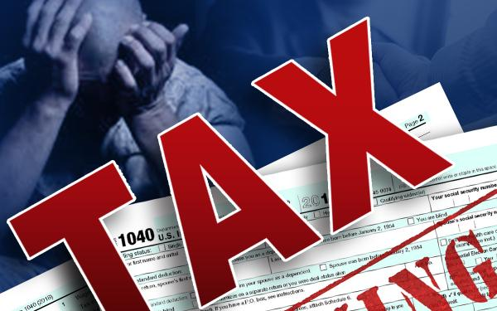
(Tax) Refund Anticipation Loans
Notes:
SHOW SLIDE 7-17: Refund Anticipation Loans
Refund anticipation loans allow a taxpayer who is due a refund to get an advance on that refund. This is a high-fee, high-interest-rate, short-term loan. Many people mistakenly regard this predatory lending as a service. For refund anticipation loans, the lender sometimes is the income tax-preparation company and sometimes is a check-cashing service or other short-term lender. The fees that are paid to get the quick refund usually are based on a percentage of the refund, so the higher the refund, the more the loan costs.
Avoid These!

Slide 18
Federal protections under the Military Lending Act (MLA) prohibit lenders from charging more than 36% on any type of loan for Soldiers
Lenders are prohibited from taking a check, debit authorization or car title to secure loans
The DoD prohibits Soldiers from obtaining Title Loans or Payday Loans
Title Loans and Payday Loans for Soldiers
Use your Military Benefits! (AER LOANS)
Notes:
SHOW SLIDE 7-18: TITLE LOANS AND PAYLOANS FOR SOLDIERS
Car title loans — and certain other financing — offered to service members and their dependents must include special protections under federal law and a Department of Defense rule. For example, the military APR for car title loans offered since Oct. 1, 2007 — with a term of 181 days or less — cannot exceed 36 percent. Most fees and charges, with few exceptions, are included in the rate. Creditors also may not require use of a check or access to a bank account for the loan, mandatory arbitration, and unreasonable legal notices. Military consumers also must be given certain disclosures about the loan costs and their rights as borrowers. Credit agreements that violate the protections are void. Creditors that offer car title loans may ask loan applicants to sign a statement about their military affiliation.
Among other stipulations, the SCRA provides protections for service members. It means that companies and individuals must obtain a court order before repossessing a vehicle belonging to a service member with active-duty status. If a lender or dealership wants to repossess a vehicle that belongs to a man or woman on active duty, it must first go through the process of obtaining an affidavit because of the individual’s military status. This is most easily accomplished via the Service members Civil Relief Act Centralized Verification Service and takes a short time for processing. After that, the service member is entitled to a stay of proceedings for a minimum of 90 days.
Once these 90 days are up, the court reconvenes to decide what to do. There are a variety of options available to the court, and the decision is generally based on the needs and responsibilities of the service member.
Payday loans are not permitted for active-duty service members and their dependents. Federal protections under the Military Lending Act (MLA) for service members and their families took effect October 1, 2007 and were expanded October 3, 2016. Department of Defense rules apply to loans subject to the federal Truth in Lending Act, including payday and title loans.. Lenders are prohibited from charging more than 36 percent annual interest including fees; taking a check, debit authorization or car title to secure loans; and using mandatory arbitration clauses in contracts for covered loans. The Consumer Financial Protection Bureau enforces the MLA rules. To file a complaint, click here. See: CFA press release on revised MLA rules

Slide 19
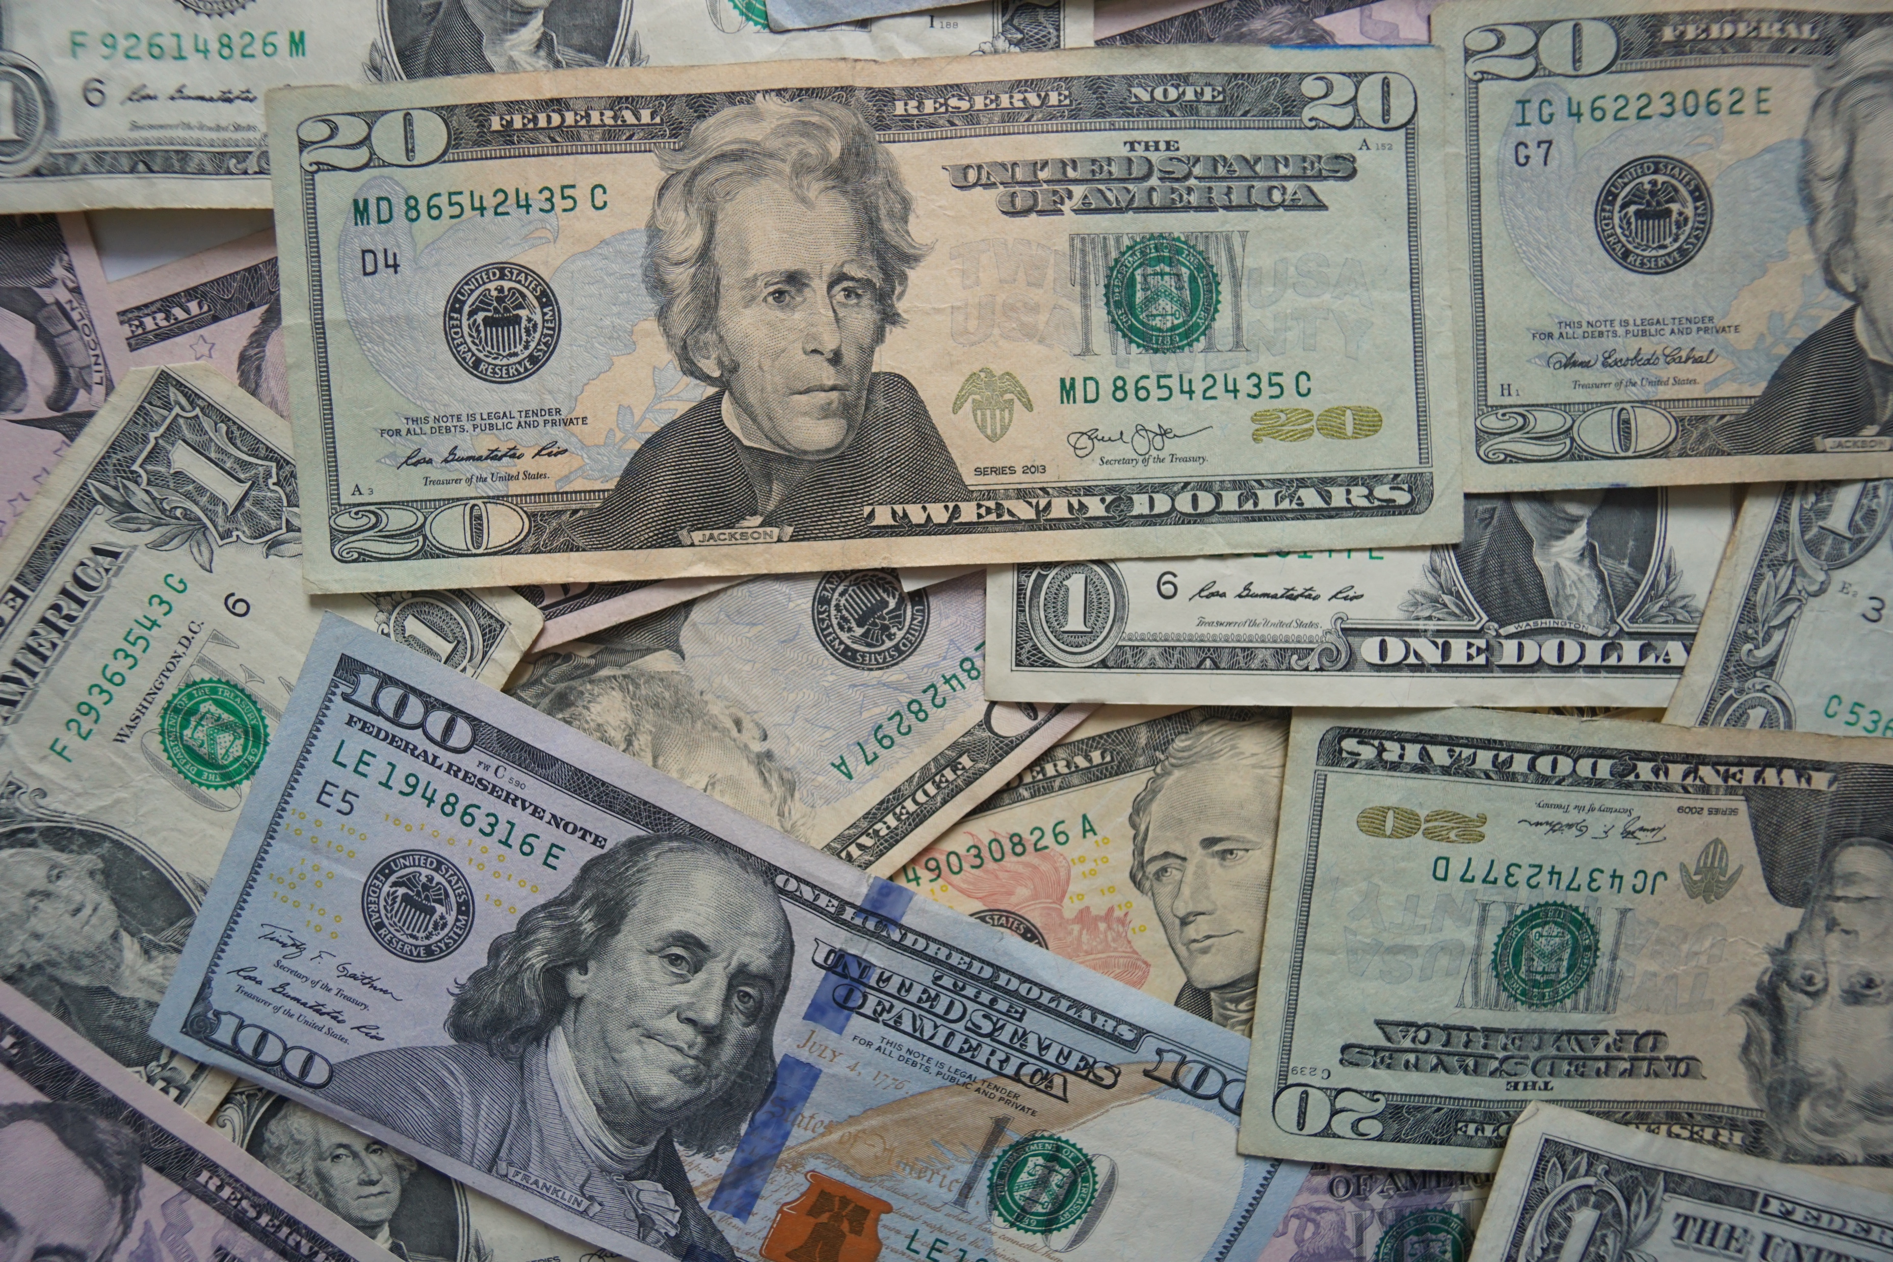
Major Purchases
Notes:
SHOW SLIDE 7-19: MAJOR PURCHASES
Making a major purchase doesn’t mean you have to risk your financial future in the process. It is possible to spend a lot and still be smart about it.
What do you consider to be a major purchase? A new car, truck or motorcycle? A home? A new gaming system? In truth, any of these could be a major purchase depending on your financial situation at the time you buy.
These major purchases might also not be a big deal if you have your financial house in order. In short, it all depends on how the purchase compares to the rest of your financial situation.

Slide 20
01
Logic beats emotion
02
Additional costs matter
Think First
03
Things change
04
Shopping around is smart
05
Cash or credit?
Notes:
SHOW SLIDE 7-20: THINK FIRST
Having a strategy before making a purchase will help to save you money, time, and potential harm.
Logic beats emotion- Be smart. Don’t let fancy marketing suck you in.
Additional costs matter- What else will you have to pay? As an example, cars require maintenance, repairs, gas and insurance. Other big purchases are often similar.
Things change-Your life can be completely different in a year or two. Will today’s purchase still make sense then or could you regret it?
Shopping around is smart-It forces you to slow down the purchase decision and be more levelheaded about what you are purchasing.
Cash or credit? Paying cash is often smarter than financing. Just don’t use all of your cash, keep some for emergencies.

Slide 21

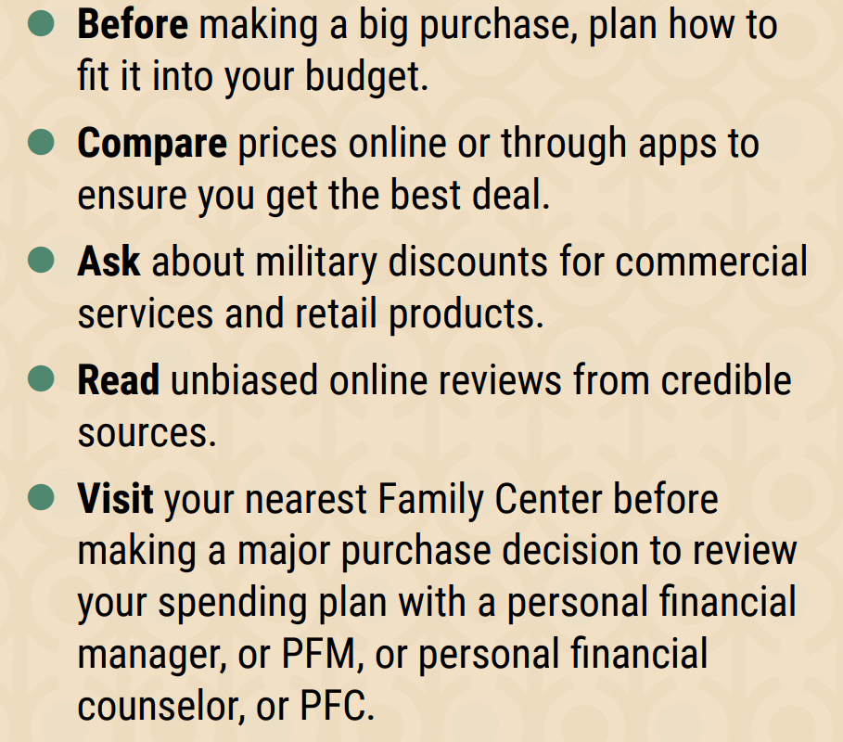
Do Your Research
Notes:
SHOW SLIDE 7-21: DO YOUR RESEARCH
It is important to make sure to do your research before making a major purchase. How will it fit into your budget? How will you pay for it? Will you need to take out a loan, put it on a credit card, or save up to pay for it with cash? Make sure to compare prices online and through different apps to ensure that you get the best deal. Many companies will price match if you find a better deal somewhere else. Also, don’t be afraid to ask for a military discount. What is the worst thing that they can say? No?
As you research, look for unbiased online reviews from credible sources. Many times, reviewers will be sponsored by the company or given the product for free and may not give the most honest review.
Ask yourself this: Is this a want or a need? Is this purchase you’re considering necessary? Be honest. For example, you may legitimately need a car, but you probably don’t need the nicest one available. You should be just as excited about making a smart purchase as you are about what you want to buy. If not, you could be headed for trouble.
Wait. One of the best ways to bypass emotional buying decisions is to implement a cooling-off period before you pull the trigger. Sleep on it-maybe for a couple of days-and see if it still seems like a good move.
Ask someone else. Ask a parent, family member or friend to be a sounding board on major purchases. Just be sure to find a helper and not an enabler. Or visit your nearest Family Center before making a major purchase decision to review your spending plan with a PFM or a PFC. Your installation legal office is also willing to look at any contracts before you sign.

Slide 22
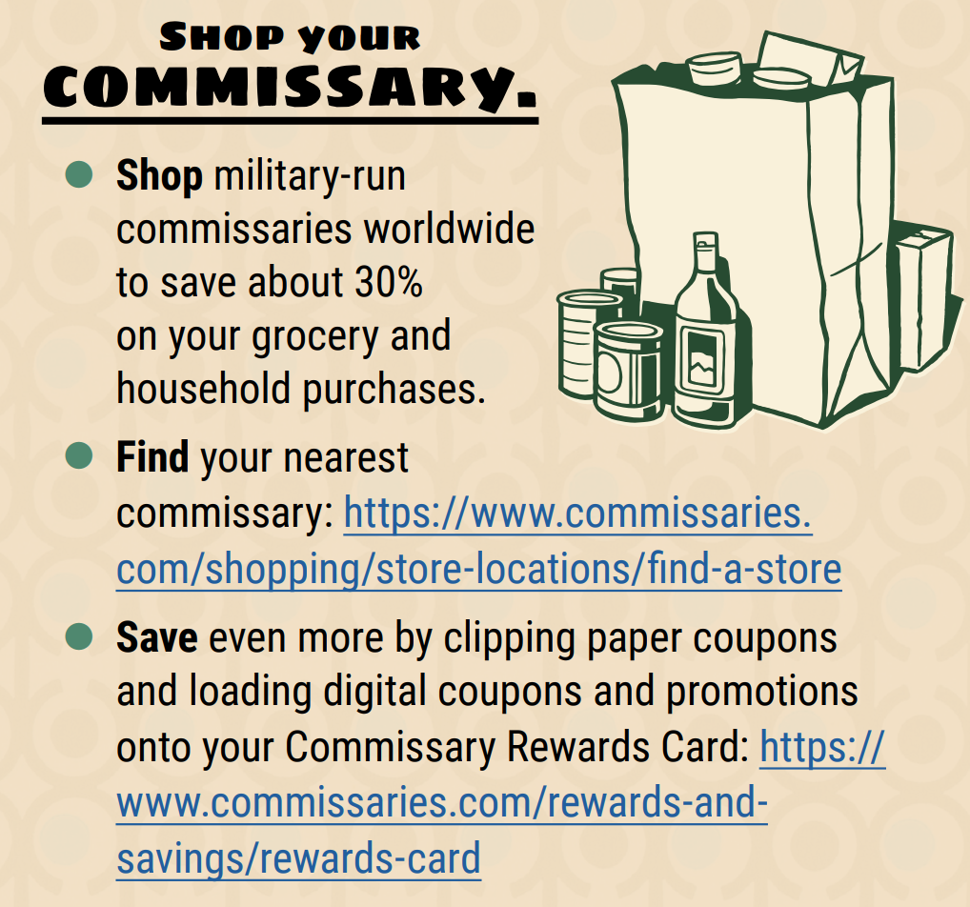
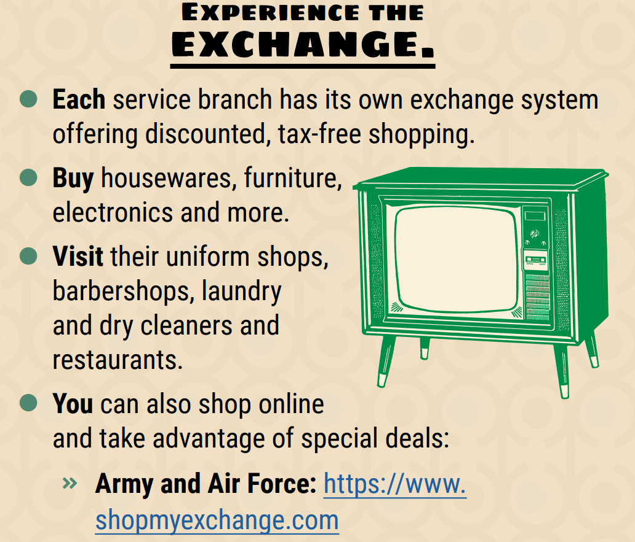
Military Shopping
Notes:
SHOW SLIDE 7-22: MILITARY SHOPPING
Military families have a variety of resources available to help make smart purchasing decisions. Take advantage of the Commissary and the Exchange on your installation for great savings and tax-free shopping!

Slide 23
Use familiar websites |  | Look for the lock
Don’t Tell All |  | Use your smartphone
Check your bank statements |  | Protect your PC
Use strong passwords |  | Privatize your Wi-fi
Never shop on a public computer |  | Don’t buy gift cards on eBay or other sites
Tips for Internet Shopping
Notes:
SHOW SLIDE 7-23: TIPS ON INTERNET SHOPPING
Use Familiar Websites
Start at a trusted site rather than shopping with a search engine. Search results can be rigged to lead you astray, especially when you drift past the first few pages of links. If you know the site, chances are it's less likely to be a rip off. We all know Amazon.com and that it carries everything under the sun; likewise, just about every major retail outlet has an online store, from Target to Best Buy to Home Depot. Beware of misspellings or sites using a different top-level domain (.NET instead of .com, for example)—those are the oldest tricks in the book. Yes, the sales on these sites might look enticing, but that's how they trick you into giving up your info.
2. Look for the Lock
Never ever, ever buy anything online using your credit card from a site that doesn't have SSL (secure sockets layer) encryption installed—at the very least. You'll know if the site has SSL because the URL for the site will start with HTTPS:// (instead of just HTTP://). An icon of a locked padlock will appear, typically in the status bar at the bottom of your web browser, or right next to the URL in the address bar. It depends on your browser. Never, ever give anyone your credit card over email. Ever.
3. Don't Tell All
No online shopping store needs your social security number or your birthday to do business. However, if crooks get them, combined with your credit card number for purchases, they can do a lot of damage. The more they know, the easier it is to steal your identity. When possible, default to giving up the least amount of information.
4. Check Statements
Don't wait for your bill to come at the end of the month. Go online regularly during the holiday season and look at electronic statements for your credit card, debit card, and checking accounts. Make sure you don't see any fraudulent charges, even originating from sites like PayPal. (After all, there's more than one way to get to your money.)
If you do see something wrong, pick up the phone to address the matter quickly. In the case of credit cards, pay the bill only once you know all your charges are accurate. You have 30 days to notify the bank or card issuer of problems, however; after that, you might be liable for the charges anyway.
5. Use Strong Passwords
We like to beat this dead horse about making sure to utilize uncrackable passwords, but it's never more important than when banking and shopping online. Our tips for creating a unique password can come in handy during a time of year (holidays) when shopping around probably means creating new accounts on all sorts of e-commerce sites.
6. Think Mobile
The National Retail Federation says that 5.7 percent of adults will use their mobile devices to do comparison shopping before making a purchase. (And 32.1 percent will comparison shop online with a computer, as well.) There's no real need to be any more nervous about shopping on a mobile device than online. The trick is to use apps provided directly by the retailers, like Amazon, Target, etc. Use the apps to find what you want and then make the purchase directly, without going to the store or the website.
7. Don’t Shop on Public Computer
Hopefully, we don't have to tell you it's a bad idea to use a public computer to make purchases, but we still will. If you do, just remember to log out every time you use a public terminal, even if you were just checking email.
8. Inoculate Your PC
Swindlers don't just sit around waiting for you to give them data; sometimes they give you a little something extra to help things along. You need to protect against malware with regular updates to your anti-virus program.
9. Privatize Your Wi-Fi
Shop online on your own, secured Wi-Fi. Shopping online is not a good time to try out a hotspot you're unfamiliar with. Stick to known networks, even if they're free, like those found at Starbucks or Barnes & Noble stores that is powered by AT&T. Look for the network named "attwifi," then open a browser to click into the "walled garden" to get final access. You can also find free Wi-Fi at McDonalds, Panera Bread, and FedEx Office locations, not to mention libraries and local cafes.
10. Count the Cards
Gift cards are the most requested gift. Stick to the source when you buy one; scammers like to auction off gift cards on sites like eBay with little or no funds on them.

Slide 24
Legal Protections
Canceling a Contract
Cooling-Off Period
Federal and State Laws
Cancel in writing
Keep copies of letters
Use certified mail
Keep receipts
Up to three days on certain purchases
Servicemembers Civil Relief Act (SCRA)
Military Lending Act
Lemon laws
Auto repair laws
Usury laws
Notes:
SHOW SLIDE 7-24: Legal Protections
The law is on your side with consumer protections
Canceling a contract:
1. Cancel in writing.
2. Keep a copy of your cancellation letter.
3. Send the cancellation by certified mail and request a return receipt, so there is a record that the cancellation request was received if a dispute arises.
4. Keep a copy of the letter and signed return receipt until money is refunded.
Add that if cancellation by telephone is possible, consumers should be sure to get the name of the person with whom they spoke and follow up the call with a letter using the four steps above. They should mention the name of the person with whom they spoke on the phone and be sure to act within three business days. (Saturdays are considered business days, whereas Sundays and holidays are not.)
Cooling-Off Period
Explain that when consumers buy something at a store and later change their mind, their ability to return the merchandise depends on the store’s policy. However, if they buy an item in their home or workplace, they might have three days to cancel the purchase and return any items received for a full refund, likewise, if they buy from a seller in a temporary location, like a convention center or fairground.
This cooling-off period also applies to purchases of $25 or more made at a home or workplace (but not online or by telephone) and to purchases of $130 or more from temporary sales venues.
Federal and State Laws
Military Lending Act
[https://www.consumerfinance.gov/ask-cfpb/what-are-my-rights-under-the-military-lending-act-en-1783/] limits military annual percentage rate (MAPR) to 36%.
State that consumers have legal rights at the state and federal level. They do not lose these rights because they are in uniform, but they do need to know what they are to protect themselves.
Lemon Laws (also known as motor vehicle warranty enforcement acts or motor vehicle warranty rights acts):
These laws allow buyers to return a new vehicle that has safety or repeat mechanical or cosmetic problems that constitute a major defect. Buyers are entitled to a refund or a replacement. Some states also have lemon laws regarding used vehicles.
State Automobile Repair Facilities Act:
Many states have enacted laws that deal specifically with businesses that repair vehicles. The laws, which vary from state to state, may deal with issues such as required disclosures on written estimates, unauthorized charges, invoices, disposition of replaced parts, or unlawful acts and practices. States that have an Auto Repair Facilities Act are listed in the Consumer Action Handbook. Buyers may also contact their state attorney general’s office or check for the information on the internet.
Usury Laws:
A usury law sets a cap on interest rates. Since there is no federal limit, each state determines its own maximum allowable rate. Almost every state has some form of usury law, but there always are businesses that can find their way around them.

Slide 25
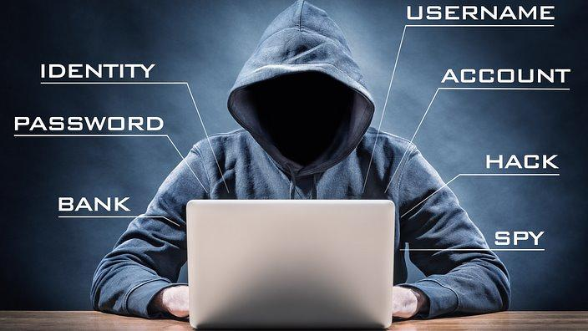
Identity Theft
Notes:
SHOW SLIDE 7-25: IDENTITY THEFT
Identity theft occurs when someone uses your personal information without your permission. They could open lines of credit, start utilities or even file taxes claiming to be you. As a result, your credit score could suffer, and your funds could get tied up in disputes over charges you didn't authorize. Even if you don't end up losing money, dealing with identity theft will cost you time and stress. Fortunately, there are steps you can take to reduce your risk.

Slide 26

Identity Theft of Service Members vs. Civilians
76% more likely to report identity theft on existing account
Three times more likely to report money taken directly from bank account through debit card/electronic means
22% more likely to have stolen information misused to open a new account
14% have a family member or someone they know steal their identity
Notes:
SHOW SLIDE 7-26: IDENTITY THEFT SERVICE MEMBERS VS. CIVILIANS
Five years of identity theft data reported to the Federal Trade Commission show that active duty Service members are 76% more likely than other adults to report that an identity thief misused an existing account, such as a bank account or credit card.
Service members are nearly three times as likely to report that someone used a debit card or some other electronic means to take money directly from their bank account.
In addition, Service members are 22% more likely to report their stolen information was misused to open a new account, especially new credit card accounts.
14% of reports indicate that a family member or someone they know store their identity.
https://www.ftc.gov/news-events/blogs/data-spotlight/2020/05/identity-theft-causing-outsized-harm-our-troops

Slide 27
Unauthorized withdrawals from bank account Missing bills Debt collection calls in your name
Credit denial Bills for services you didn’t receive or use
IRS notification for more than one tax return in your name Unauthorized accounts on credit reports
Warning Signs of Identity Theft
Notes:
SHOW SLIDE 7-27: SPOT THE WARNING SIGNS OF IDENTITY THEFT
Once identity thieves get hold of your personal information, they can use it in a number of different ways. If you remain vigilant, you may be able to stop them in their tracks and minimize the damage they intend to cause. Keep an eye out for these clues that someone may have stolen your personal information:
1. You see withdrawals from your bank account that you didn't authorize or can't explain.
2. Some of your bills stop being delivered, but you haven't made changes to your accounts.
3. You receive debt collection calls about debts that aren't yours, but are in your name.
4. Credit denial
5. You receive medical bills for services you didn't receive or use.
6. The IRS notifies you that it received more than one tax return in your name, or you have income from an employer you don't work for.
7. You find unfamiliar accounts or charges on your credit report.

Slide 28
Stolen wallet or purse Internet- hacking and fake website links “Inside Sources”
Dumpster Diving U.S. Mail Trick you into disclosing personal information
Data breaches Skimmers & RFID Tags
Identity Theft-How?
Notes:
SHOW SLIDE 7-28: IDENTITY THEFT - HOW?
No one can steal your identity without some amount of personal information.
Here are a few ways someone can get their hands on your personal information:
A stolen wallet or purse,
Bought from "inside sources,"
Going "dumpster diving“, obtaining it from bills and receipts carelessly deposited in your garbage
Stealing or re-directing your mail.
Skimmers and Shimmers: Before shimmers, cardholders already were facing additional threats from so-called deep-insert skimmers. Those devices are placed well inside a payment device, these devices can transmit the stolen data wirelessly, so scammers don’t need to return to the location to fetch the device. Skimmers are even being found in the card readers customers use to gain after-hour access to ATMs in locked bank vestibules. There was a 70% increase in in the number of debit cards that were compromised in 2016 at ATMs and at card readers used by merchants.
New developments in data recording make it possible to access a credit card's data without swiping it through a point-of-sale terminal. These contactless cards incorporate radio frequency ID tags that a merchant can read at a distance with a scanner. The same RFID technology provides the basis for toll-pass cards that register each time you drive by a highway payment point and employee badges that unlock gates and doors when you wave them in front of a scanning device. Inside your RFID-enabled credit card, a tiny radio antenna draws credit data from a microchip and makes it available to a purchase terminal. The convenience these cards offer comes with a built-in negative. With a pocket-sized radio frequency scanner that can cost less than $100 or a smartphone equipped with near field communications capabilities, thieves can obtain the data from a credit card right through your wallet and purse, providing they stand close enough to you for a sensor to register the information. Early generation credit cards with RFID tags encode the card information necessary to make a large purchase, unlike newer cards, which minimize their scanner-readable data.

Slide 29
What Thieves Do with Your Information
Use existing credit or debit card
Commit fax or employment fraud
Obtain new credit card
Obtain medical/social Security benefits
Utilities (Including buying, reselling phones)
Open a new bank account, line of credit
Get a car loan
Other
14%
3%
3%
4%
36%
6%
13%
21%
Notes:
SHOW SLIDE 7-29: WHAT THIEVES DO ONCE THEY STEAL YOUR INFO
Armed with enough information, a crook can open a bank account in your name and write bad checks on it.
They can use your credit card or apply for a new card in your name.
If they have diverted your bank statements, you may not be aware of what is happening to you until it is too late.
They could even obtain a drivers license in your name.
They can commit tax/employment fraud

Slide 30
Handle mail carefully | Safeguard wallet
Keep receipts | Minimize what you carry on your person
Place active-duty alert during deployments | Check credit reports
Close tampered accounts | Use strong passwords
Defending Against Identity Theft
Notes:
SHOW SLIDE 7-30: DEFENDING AGAINST IDENTITY THEFT
There is no way to completely prevent Identity Theft. However, the risk can be minimized.
One way to protect yourself from identity theft is to minimize personal information, credit cards carried.
Use a cross-cut shredder to dispose of receipts, copies of credit applications, insurance forms, checks, bank statements, expired charge cards, and any credit offers you get in the mail prior to discarding.
Use strong passwords for all of your online accounts. Use at least 8 characters, alpha numeric, symbols, and upper/lower case.
Read credit reports annually by going to annualcreditreport.com for a free credit report. The military has access to free credit monitoring. Visit the credit bureaus for more information or visit financialfrontline.org for a handout.
Place active-duty alert during deployments.
Close any tampered accounts and take the appropriate action.
Keep receipts of your purchases, bills paid, and checks cashed.

Slide 31
Contact and Implement Fraud Alert with all three major credit bureaus
Request copies of your credit report
File a police report
Contact your creditors and bank
Use identitytheft.gov
What to Do If Your Identity Is Stolen
Notes:
SHOW SLIDE 7-31: WHAT TO DO IF YOUR IDENTITY IS STOLEN
Contact the fraud department of one of the three major credit bureaus. The company you call must tell the other companies about your fraud alert. An initial fraud alert can make it harder for an identity thief to open more accounts in your name. When you have an alert on your report, a business must verify your identity before it issues credit in your name, so it may try to contact you. Be sure the credit reporting companies have your current contact information so they can contact you. The initial alert stays on your report for 90 days. It allows you to order 1 free copy of your credit report from each of the 3 credit reporting companies. Remember that a credit report details all your financial transactions for approximately seven years, and it can give you some indication of how much damage to your credit has been done.
Contact your creditors, even those that have not been opened by you. Follow up with a letter.
File a report with your local police department. Keep a copy in case your creditors need proof of the crime.
As an identity theft victim, you have protections under federal law for ATM or debit card transactions. Federal law also limits your liability for the unauthorized electronic transfer of funds that result from identity theft. It’s best to act as soon as you discover a withdrawal or purchase you didn’t make or authorize. Many card issuers have voluntarily agreed that an account holder will not owe more than $50 for transactions made with a lost or stolen ATM or debit card. However, under the law, the amount you can lose depends on how quickly you report the loss. If you don’t report within 60 days of the day your institution sent you the account statement showing the unauthorized withdrawals, you could lose all the money an identity thief took from your account.
An identity thief may steal your paper checks, misuse the account number from the bottom of your checks, or open a new account in your name. If this happens, contact your bank or financial institution and ask them to close the account as soon as possible. Federal law doesn’t limit your loss if a thief forges your signature on your checks or uses your account number to buy something by phone, but most states hold banks responsible for losses from those fraudulent transactions. However, banks expect their customers to take reasonable care of their accounts. That means you might be responsible for a loss if you know about a problem but don’t report it to your bank quickly.
Your liability for credit card charges that you didn’t authorize is limited to $50 per card. To dispute fraudulent charges, contact the credit card issuer within 60 days of the day the credit card issuer sends you the bill showing the fraudulent charges. What if an identity thief changed the address on your account and you don’t get your statement? You are responsible for keeping track of your statements. If your statement doesn’t arrive on time, contact your credit card company.
7. www.IdentityTheft.gov is a website that helps you recover from identity theft. You answer questions about what happened to you, put in your name, address, and other information,
get your Identity Theft Report, get a recovery plan created just for you.
You also can create an account. The account helps you through the recovery steps and tracks your progress. An Identity Theft Report helps you fix your bills and your credit report. Your Identity Theft Report tells your creditors that you should not have to pay for what the identity thief spent. You get an Identity Theft Report when you report a problem to IdentityTheft.gov. This is your statement about what happened. It lists what accounts are not yours and what charges you did not make.

Slide 32
How to File a Complaint
Save all purchase-related paperwork.
Contact the business.
Send a complaint letter by certified mail, return receipt requested.
**A sample complaint letter is included in your PFMC Student Handout
Notes:
SHOW SLIDE 7-32: HOW TO FILE A COMPLAINT
Save all purchase-related paperwork. Include copies of receipts, repair orders, warranties, canceled checks. Contracts and any letters to and from the company.
If you have a problem:
Contact the business-start with the salesperson with whom you dealt or the manager. Clearly and calmly describe the problem and the action you would like them to take. Document their response in writing.
Contact the company president or a representative of the manufacturer. Use the Sample Complaint Letter. Send it by certified mail, return receipt requested.
Contact industry trade associations.
Contact local and state consumer advocates for further assistance. Don’t give up until you are satisfied.
Talk to a PFM or a PFC on your installation and visit financialfrontline.org for a handout with the sample complaint letter.

Slide 33
Consumer Awareness Summary
Recognized and understood how to protect yourself from misleading consumer practices & report complaints.
Know military consumer protection law fundamentals.
Recognized and identified steps to resolve identity theft.
Notes:
SHOW SLIDE 7-34: CONSUMER AWARNESS SUMMARY
In today’s lesson, we covered some of the most common types of deceptions, how marketing and advertising play a part, and looked at ways that you can protect yourself from misleading consumer practices. We went over how to report complaints and what military consumer protection laws there are. We also explored what identity theft is, and how you can protect yourself from becoming a target..

Slide 34
Sources of Assistance
Chain of Command
Financialfrontline.org
Army Community Service (ACS)
Army Emergency Relief (AER)
Armed Forces Disciplinary Control Board
Legal services
Better Business Bureau (BBB)
Consumer Financial Protection Bureau (CFPB)
Federal Trade Commission (FTC)
Militaryconsumer.gov
Military OneSource
Notes:
SHOW SLIDE 7-35: SOURCES OF ASSISTANCE
SUMMARY
Throughout this course we will emphasize that you, as members of the military, have a wide range of assistance available to you absolutely free of charge. Among these are the Army Community Service Center and Army Emergency Relief. Rely on these sources for help.

Slide 35

Any Questions?
Notes:
SHOW SLIDE 6-35: Questions
NOTE: Ask students if they have any questions.

Slide 36

Check on Learning
Notes:
SHOW SLIDE 7-36: CHECK ON LEARNING
NOTE: Conduct a check on learning and summarize the learning activity.

Slide 37
Question #1
When should you consider getting a payday loan?
The day before payday
Immediately after a promotion
When your next payday will fall on a weekend or holiday
You should never consider a payday loan
D. You should NEVER consider a payday loan
Notes:
SHOW SLIDE 7-37: CHECK ON LEARNING
Question:
When should you consider getting a payday loan?
Answer: d.
You should never consider a payday loan.
Look into the Army Emergency Relief Society for interest free loans.

Slide 38
Question #2
Before making a big purchase, what should you consider?
Budget
Comparison shop
Ask for discounts
Read credible reviews
All the Above
E. All the Above
Notes:
SHOW SLIDE 7-38: CHECK ON LEARNING
Question: Before making a big purchase, what should you consider?
Answer:
Budget
Comparison shop
Ask for discounts
Read credible reviews
Talk with a Personal Financial Counselor

Slide 39
Question #3
What are a few warning signs of identity theft?
Unauthorized withdrawals
Missing bills
Debt collection calls in your name
Bills for services you did not receive or use
All the Above
E. All the Above
Notes:
SHOW SLIDE 7-39: CHECK ON LEARNING
Question: What are warning signs of identity theft?
Answer:
Unauthorized withdrawals from bank account.
Missing bills.
Debt collection calls in your name.
Credit denial.
Bills for services you didn’t receive or use.
IRS notification for more than one tax return in your name.
Unauthorized accounts on credit reports.

Slide 40
Question #4
    What step should you NOT take when your identity has been stolen?
      Destroy your credit cards
      File a police report
      Place a fraud alert with the credit bureaus
      Nothing. The bank will take care of it.
D. Nothing. The bank will take care of it
Notes:
SHOW SLIDE 7-40: CHECK ON LEARNING
Question: What step(s) should take when your identity has been stolen?
Answer: B and C

Slide 41
Question #5
    True or False: The following are all considerations when filing a complaint:
      Save all purchase-related paperwork
      Contact the business
      Send a complaint letter by certified mail, return receipt requested
TRUE
Notes:
SHOW SLIDE 7-41: CHECK ON LEARNING
Question: The following are all considerations when filing a complaint:
Save all purchase-related paperwork
Contact the business
Send a complaint letter by certified mail, return receipt requested
Answer: True.

Slide 42
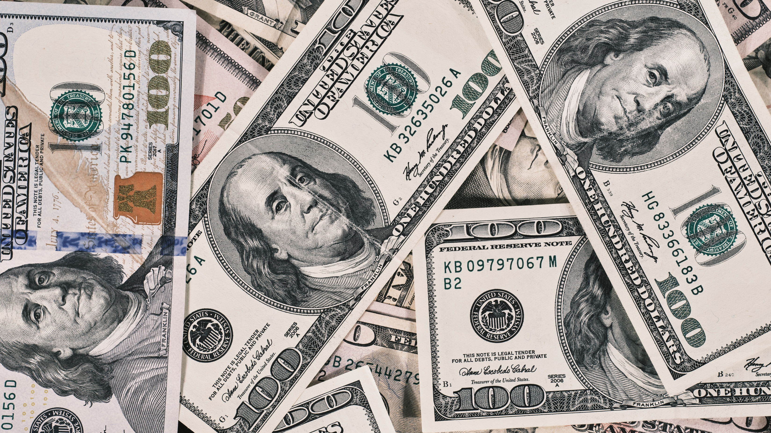
End of Lesson 7!
Notes:
Slide 7-42: Take a few moments to allow for a restroom break if needed. If not, continue on to Lesson 8.

