Slide 1

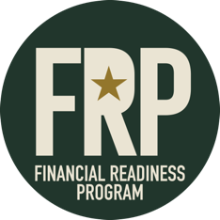
Lesson 6:
Essentials
of
Credit
Notes:
Learning Activity 6-1. : Identify the Essentials of Credit
Method of Instruction: Classroom/Discussion
Instructor to Student Ratio: 1:25
Time of Instruction: 60 Min.
Media: Large Group Instruction
Required Student Materials:
Writing Utensil
PFMC Student Booklet
Objectives in this lesson:
Recognize and understand how to protect yourself from misleading consumer practices and report complaints
Understand the fundamentals and management of debt and credit

Slide 2

Factors that Influence your Credit
Other Factors:
Types of Loans and Credit
Credit History
Human Factors (Gender and Age)
Maxed out Credit Cards
Accounts in Collections
Loan Defaults
Home Foreclosure/Vehicle Repossession
Bankruptcy
According to FICO, the 5 MAJOR factor considered by percentage are:
Payment History – 35%
Amount of Debt Owed – 30%
Age of Credit History – 15%
New Lines of Credit – 10%
Credit Mix (amounts and types of credit) – 10%
Notes:
SHOW SLIDE 6-1: FACTORS THAT INFLUENCE YOUR CREDIT
Credit has become a normal part of everyday personal financial management for most Americans. Used appropriately, it can be an excellent tool. For example, credit can help you buy expensive items, like vehicles when you need them and when they are priced right, with a minimal effect on your cash flow. However, poor credit management can devastate your financial health and disrupt multiple aspects of your life.
Credit can influence almost every aspect of your lives, not just your finances. Those who have good credit can use it to reach their financial goals and be successful in other areas. Those who have poor credit will struggle to make their goals a reality.
Some examples of the Essentials of Credit include:
Credit history
Interest rates
Fees
Payment schedules – do you make your payments on time?
Impulse buying – do you use your credit card without considering the purchase?
This lesson will focus on the essentials of credit, as well as ways you can improve your credit trustworthiness.

Slide 3


Creditworthiness: The 3 C’s
Your “Creditworthiness” is the way a financial institution or company will evaluate the probability that you will make required payments on time. The “3 C’s” listed below weigh heavily on those decisions.
Character
Credit History
  Record of Responsibility
  Stability
    Housing & Employment
  Bank Account History
  Bill Payments
    On time, every time
Capacity
Income
  Potential Credit
  Total Debt Level
  Living Expenses
  Dependents
Collateral
Home
  Car
  Motorcycle
  Other Valuables
How Credit Worthy
Are You?
Notes:
SHOW SLIDE 6-3: Creditworthiness
Ask yourself: Are you a good credit risk?
Before deciding whether to grant you a loan, or other types of credit, and at what interest rate, a financial institution or company will evaluate the probability that you will make required payments on time. The three factors that weigh heavily in those decisions are:
Character
Capacity
Collateral
These three are otherwise known as your “Creditworthiness.” Note that different creditors may reach different conclusions based on the same set of facts.

Slide 4
Share-Secured Loan
Co-Signed Loan
Retail Cards
Major Credit Cards
Establishing
Credit
Notes:
SHOW SLIDE 6-4: Establishing Credit
You should start building your credit history early, so you will be able to get credit when you need it. Someone who does not have a credit history should start by properly maintaining a checking and/or savings account and paying all bills on time. But remember, success or failure with finances depends much more on knowledge and appropriate behavior than it does on the amount of money you have.
Here are other options that can help establish a credit history:
Share-secured loan: This is collateralized by money in a savings or share savings account. Credit unions and banks will grant a loan up to the amount of money in the borrower’s account. The money in the account is frozen until a predetermined portion or the entire loan is paid off. Since the repayment is already guaranteed, even if the borrower defaults on the payments, the interest rate on a share-secured loan is usually low. True, the borrower is paying to borrow his or her own money, but the idea is to help establish a credit history, and a share-secured loan can be a good way to do that.
Co-signed loan: This is a good option for borrowers with little credit history, but they will need someone with an established credit history to co-sign for the loan. However, be very careful if you are asked to be the co-signer for someone. It could put you at risk. Review your Spending Plan, could you make the payments? If not, co-signing may not be your best move.
Retail cards: Another option is to get a charge card from a retail store or oil company. These charge cards often are the easiest types of credit cards to get but can carry higher interest rates and fees as compared to major credit cards.
Major credit cards: Note that after establishing a credit history, consumers can usually qualify for a Visa, MasterCard, American Express, or Discover card from a major bank or credit union. Learners should be aware that terms and rates for bank credit cards will vary considerably, ranging from “secured” cards that often require a cash deposit, have low credit limits and high rates, and hidden fees or “membership” costs for the “premium” cards (often called gold or platinum), which are targeted at consumers with the best credit ratings.

Slide 5

How Can I Improve My Credit?
Use revolving credit cards
Extend car loans to 72 months
Pay your bills on time – Set up automatic bill payment
Pay more than the minimum balance
Save up for expensive items
Check your credit score regularly
Notes:
SHOW SLIDE 6-5: Ways to Improve Your Credit
There are several ways to improve your credit score safely and effectively.
Revolving credit cards make it easy to access funds as needed up to your predetermined credit limit. And when you consistently manage your revolving credit accounts responsibly, you might even be able to improve your credit scores
Extending your car loans to 72 months can often get you a better rate and will offset and additional interest you’d pay over a longer term.
Paying bills on time leads to an improved credit score, and an improved credit score leads to lower monthly payments when it's time to take out a loan. Whether you're buying a car or getting a mortgage for a house, you can get better interest rates with a higher credit score. Setting up automatic payments for your bills is an easy way to make sure you never miss a payment.
Contributing more than the minimum payment can eliminate debt faster, save money on interest charges and maintain a healthy credit score.
Saving up for expensive items versus putting them on a credit card eliminates large amounts being on your credit card bill that you may not be able to pay off all at once. If you leave a balance on a credit card, you will end up paying interest on those purchases. It is best to take the time to save for larger items so you can pay in full at the time of purchase.
Checking your credit score regularly helps you know where you stand and where improvements need to be made. It is important to always keep an eye on you credit score and immediately address any discrepancies to avoid damage to your overall score.

Slide 6
Wise and Unwise Uses of Credit
Wise | Unwise
Planned Purchases | Impulse Buying
Convenience | “Retail Therapy”
Management Tool | Status Spending
Sales or Discounts | Revenge Spending
Emergencies | Everyday Expenses
Notes:
SHOW SLIDE 6-6: Wise and Unwise Uses of Credit
Once credit is established, it is important to use it wisely. Good credit management is the result of understanding options and planning effectively for how to use credit.
List some of the best uses for credit:
A planned purchase of assets—things that will grow or increase in value over time, such as a home or an education.
A convenience to avoid having to carry large amounts of cash.
As a financial management tool that records spending on statements and/or downloads to electronic financial management tools.
To take advantage of sales or discounts when you do not have immediate access to cash.
A means to pay for emergency travel and or a major repair to your home or car.
Note that unwise uses of credit revolve around behavior, such as poor or no planning or emotional spending. List unwise uses of credit, which may include:
Impulse buying: Easy access to credit often leads to a “buy now, pay later” mentality, especially when people are bored, nervous, sad, angry, or happy.
Retail Therapy: Spending to feel good. As is true of other addictive behaviors, good feelings are temporary, whereas the debt can last a long time.
Spending for status: Many people believe they need to spend money to impress others. In truth, spending to impress others may only result in large credit payments that put a strain on monthly budgets.
Retaliatory spending: In a family that does not have a clear spending plan on which partners agree, each person may spend on him- or herself first or buy (charge) more for him- or herself to “even the score” with the other person.
Everyday living expenses: Paying everyday living expenses like utility bills with credit could be a red flag indicating serious overextension of the household budget if you are not paying off the full amount each month.

Slide 7
There are three general categories of credit accounts that can impact your credit scores: revolving, mortgage, and installment. Although having a variety of credit types can be good for your credit health, it’s not the most important factor in determining your scores.
Mortgage Credit
Installment Credit
Revolving Credit
Types of Credit
Notes:
SHOW SLIDE 6-7: Types of Credit
When you hear the word credit, the first thing that probably comes to mind is a credit card. And, for good reason! Credit cards are a very popular form of revolving credit. The truth is, there are actually three types of credit accounts: revolving, installment and mortgage.
Revolving Credit: A revolving credit account allows you to borrow money against a line of credit and pay it back over time with monthly payments, which is often calculated as a percentage of your balance. Revolving credit accounts usually come with assigned credit limits and are subject to finance charges and fees. The types of fees that could be charged depend on the type of revolving credit account and how you use it — remember you’re in control. And, depending on terms of the account, you may be able to avoid interest charges by paying in full each month. Examples: credit cards, personal lines of credit, home equity lines of credit)
Installment Credit: Installment credit comes in the form of a loan with a fixed loan amount, fixed payments and an established repayment schedule. Unlike revolving credit, installment credit gives you an exact timeframe to pay off what you borrow, generally over a period of months to years. In addition, you don’t have access to available credit like you would with a credit card – you borrow a lump sum, receiving the total amount of the loan all at once. Examples: personal, student, auto, or mortgage loans)
Open Credit: The least common of the three, open credit — as in a charge card — comes with a credit line that allows you to make electronic purchases like a credit card. Unlike a credit card, charge cards don’t come with interest rates, but you are required to pay your balance in full each month to avoid penalties.

Slide 8
Revolving Credit Scenario
Amount Charged | $5,000
Interest Rate | 18%
Minimum Payment | 2%
Total Interest Paid | $13,931
No. of Monthly Payments | 553
Total Years | 46
Revolving
Credit
Example
$5,000 + $13,391 = $18,931 PAID!
Notes:
SHOW SLIDE 6-8: Revolving Credit Scenario
Look at this revolving credit example.
You charge $5,000.00 on your credit card and have an 18% interest rate. Each month, you only pay the minimum of 2% of the balance. This credit card will take you 46.1 years to pay off and will end up costing you an extra $13,931 in interest. That means you will have paid a total of $18,931!

Slide 9
Creating Healthy Credit Habits
Create and follow a budget
Pay bills on time
Strive to pay off credit cards in full each month
Do not apply for credit you do not need
Keep credit card and loan information in a safe and secure place
Check your online (or paper) bank statement frequently and immediately report and discrepancies
Notes:
SHOW SLIDE 6-9: Creating Healthy Credit Habits
Create and follow a budget
Pay bills on time
Strive to pay off credit cards in full each month
Do not apply for credit you do not need
Keep credit card and loan information in a safe, secure place
Keep your receipts and compare charges when your bill statements arrive.

Slide 10

Government Travel Charge Cards (GTCC)
Type of card issued reflects credit rating
GTCC is for official travel ONLY
Discipline will follow for misuse
Notes:
SHOW SLIDE 6-10: Government Travel Charge Cards
Government Travel Charge Cards
Inform learners that they may need to acquire a government travel charge card.
Explain that applicants undergo a credit check and, depending on their credit score, may receive a standard card, a restricted card, or no card.
Emphasize that government travel cards are issued only for official travel- related expenses.
Cardholders who misuse their DoD travel cards are subject to administrative or disciplinary action

Slide 11
Short-Term Loans
Advantages:
Fast Approval
Shorter Duration of Payment
Less Interest Compared to Long-Term
Disadvantages:
Higher Monthly Payment
Can add to the problem
    Cost To Finance $12,500 at 6% APR
Term of Loan | Monthly Payment | Total Interest Paid
3 years | $380.35 | $1,189.87
Notes:
SHOW SLIDE 6-11: Short-Term Loans
In order to use credit to your advantage, you need to understand the differences between short-term and long-term loans.
First, let’s start with learning a little bit about short-term loans. A short-term loan is designed to meet short-term financing needs.
Advantages:
Provides you with the money you need quickly
Often does not put a heavy emphasis on the borrower’s credit history.
Short-term loans usually offer a better interest rate than longer-term loans. In addition, even if rates are the same, the short-term loan will save you money in interest over a longer loan.
Disadvantages:
They add to the problem. Often people who take out short-term loans are short on cash. They cannot afford to keep up with their bills, so they take out a short-term loan. However, these individuals often face the problem of not having the money to payback the loan once it is due. This adds to the total amount of the loan and makes your payments higher.
Because the term of the loan is shorter, the monthly payments are often higher

Slide 12
Long-Term Loans
Advantages:
Lower Monthly Payment
Higher Borrowing Limit
Longer Repayment Terms
Disadvantages:
More Total Interest Paid
Payments may Outlast the Item
    Cost To Finance $12,500 at 6% APR
Term of Loan | Monthly Payment | Total Interest Paid
5 years | $241.66 | $1,999.60
Notes:
SHOW SLIDE 6-12: Long-Term Loans
For larger expenses, long-term financing is often the better option.
Advantages:
Higher borrowing limit
Longer repayment terms
Lower monthly payments
Disadvantages:
Higher interest paid
Items purchased can wear out and may need replaced before the loan is paid in full

Slide 13

Managing Debt
Too much of a good thing is NOT a good thing
Notes:
SHOW SLIDE 6-13: Managing Debt Section

Slide 14
Demographics of Debt
For more information, visit www.debt.org. Debt.org is an organization that provides thorough, accurate, and accessible online information about personal finances.
Notes:
SHOW SLIDE 6-14: Demographics in America
While anyone can get into debt and have trouble paying their bills, the latest American debt statistics show that younger people are falling behind faster and going into delinquency, particularly on credit cards and auto loans.
Younger borrowers have surpassed pre-pandemic rates on delinquency. Delinquency rates for older borrowers are rising but haven’t reached pre-pandemic levels.
Here’s a look at how much nonmortgage debt Americans have by age group, and the average non-mortgage per capita debt for each group:
18-29-year-olds: $69 billion total, $12,871 average
30-39-year-olds: $1.17 trillion, $26,532 average
40-49-year-olds: $1.13 trillion $27,838 average
50-59-year-olds: $98 billion, $23,719 average
60-69-year-olds: $64 billion, $16,661 average
70 and older: $36 billion $9,827 average

Slide 15

Having less than one month’s pay in savings
Making minimum monthly payments on credit cards
The amount owed to creditors increases each month
Falling behind on payments and receiving late notices
Using credit to pay regular living expenses without paying off the entire amount
At or near credit limits on credit cards most of the time
Warning
Signs of
Credit Trouble
Notes:
SHOW SLIDE 6-15: Warnings Signs of Credit Trouble
Warning signs of too much debt.
There are several signs (in addition to your debt-to-income ratio) that might hint that you are going down the wrong road financially.
1. Having less than one month of take-home pay in savings.ͧ
2. Making minimum monthly payments on credit cards.ͧ
3. The amount owed to creditors increases each month.ͧ
4. Falling behind on payments and receiving late notices.ͧ
5. Using credit to pay regular living expenses without paying off the entire amount
6. At or near credit limits on credit cards most of the time.
Point out that financial counseling at Army Community Service can help borrowers make a debt- reduction plan before debt reaches a critical stage, which is when an individual or family is:
1. Rotating bills—paying some bills this month, some next month.
2. Borrowing or getting cash advances to make payments—using credit to pay credit
3. Being denied additional credit
4. Hiding bills or being dishonest with family members about debts.
ͧ5. Seeking additional debt from predatory lending sources, such as payday loans or refund anticipation loans.
Emphasize that at the critical point, financial counseling is essential to establish a plan and/or to provide outside sources of help to reduce debt to a manageable level.

Slide 16
Recovering from Excessive Debt
Take
Charge
Prioritize
Debts
Power
Pay
Talk with
Creditors
Get Legal
Counsel
Change
Behavior
Notes:
SHOW SLIDE 6-16: Recovering from Excessive Debt
Installation legal office should be the authority on dealing with collection agencies in all circumstances
State that those who struggle with debt have options that can help them better manage their current debt load, including:
Take charge: Develop a workable budget/spending plan. Do what is necessary to establish a positive monthly cash flow.
2. Prioritize debts: Major items, such as rent/mortgage and car payments, should be the top priorities.
3. Use a power payment plan: After budgeting to get a positive flow, they should ensure that minimum payments are made on all monthly bills, and then prioritize debts to apply all remaining available funds to whichever debt has the smallest balance or highest interest rate. When the balance is paid off, apply the money used for that payment to the next bill on your list and keep the others the same. Again, when that bill is paid off, apply all the money used for the payment to the next bill on their list. ACS financial counselors and financial educators have a computerized budgeting program and power payment plan that make setting up a personal debt payment plan easy and flexible.
4. Talk with creditors: Debtors should stay in contact with their creditors. Talk with creditors: Debtors should stay in contact with their creditors.
5. Contact the installation legal office: They can safely ask questions there about dealing with collection agencies.
ͧ6. Change behavior: Remember that overcoming debt is more about behavior than financial knowledge.
An ACS personal financial counselor and educator can help Soldiers figure out what to change so that their behavior moves in the direction of building wealth, not drowning in debt. The following are some popular recommendations:
-Have a working budget or spending plan, keep it up to date, and live within their means.
-Plan all credit purchases; make sure they fit into their budget.
-Shop around for credit; it is just like any other product a consumer would buy. Look for the best deal.
-Soldiers should check their credit report regularly and keep it spotless.
-Use all available resources to help manage debt wisely and to ultimately get out of debt.
Remember, financial readiness is mission readiness!

Slide 17
Get A Grasp On Your Finances
Create A Budget
Use A Debt Repayment Strategy
Use Your Military Resources And Benefits
Avoid Payday Loans And Financial Scams
Consider Credit Counseling
Tackling Your Debt
To Learn More, Visit:
https://www.militarymoney.com/debt/how-to-manage-debt-while-in-military/
Notes:
SHOW SLIDE 6-17: Tackling Your Debt
1. GET A GRASP ON YOUR FINANCES
A good first step for successfully managing your debt is to always know the answers to two basic questions: How much money do you earn? How much are you spending?
2. CREATE A BUDGET
A healthy financial picture is always aided by sticking to a budget. Itemize your necessary debts and expenses (food, shelter, transportation costs) with your optional spending (restaurant and bar tabs, hobbies, etc.), and then analyze how you can improve the picture.
3. USE A DEBT REPAYMENT STRATEGY
True financial freedom happens when you pay off your debt, and there are several strategies that can help you cross the finish line.
4. USE YOUR MILITARY RESOURCES AND BENEFITS
Serving in the military gives you access to benefits and programs that can help you manage your debt and improve your financial picture.
5. AVOID PAYDAY LOANS AND FINANCIAL SCAMS
There’s no shortage of scams aimed at separating you from your hard-earned money, and many of these target military personnel. Payday loans, for example, are so easy to obtain yet so burdensome that the Department of Defense classifies them as a threat to military readiness.
6. CONSIDER CREDIT COUNSELING
If making sense out your finances and how to improve your credit feels overwhelming, it might be time to contact a nonprofit debt management program and work with a trained credit counselor.

Slide 18
Situations to Avoid
Credit Clinics
Debt Consolidation Loans
Spending behavior MUST change
You don’t need them to do the work for you
Bankruptcy
Last Resort
Long-term effects (7-10 years)
Notes:
SHOW SLIDE 6-18: Situations to Avoid
As stated, there are both right and wrong ways to deal with your creditors. Here are some situations your should avoid:
(1) Credit clinics. These companies charge up-front fees promising to “clean up your credit report” fast and get you out of debt. They cannot do anything for you that you cannot do for yourself. Charging up front fees for debt counseling is illegal in a number of states.
(2) Debt consolidation loans. Debt consolidation loans are not always bad, but they only a temporary fix, at best. A debt consolidation loan will never work, unless you exhibit a change in your spending behavior. A study by American Express indicated 78% of all consumers who take out bill consolidation loans have a higher debt-to-income ratio 18 months later than when they first took out the loan.
(3) Bankruptcy. Declaring bankruptcy does not allow you to walk away from all past problems. This is a last resort option that may have lasting consequences. It can severely impact your ability to get credit in the future, in addition to having potentially negative career implications.

Slide 19

Consequences of Delinquent Accounts
Credit Score Decrease
Loan Default
Difficulty Obtaining New Credit
Garnishment of Wages
Withholding of Tax Returns
Security Clearance Issues
Notes:
SHOW SLIDE 6-19: Consequences of Delinquent Accounts
Delinquency commonly refers to a situation where borrowers are late or overdue on a payment, such as student loans, income taxes, mortgage loans or automobile loans.
There are long-term consequences for delinquency, depending on the type of loan, and the duration and cause of the delinquency.
Example 1: A Soldier takes out a loan from a bank and then becomes 90 days delinquent. He risks suffering the following:
A decrease in his credit score for a considerable period (7-10 years if he applies for bankruptcy)
Defaulting on the loan, which could cause the bank to foreclose on his home (long-term delinquency).
Further negative effects on his credit rating, which would make it difficult for him to obtain credit cards, mortgages, or automobile loans.
Example 2: Assume a recent college graduate obtained student loans throughout his stay at college. Suppose too he fails to make his first loan payment. Consequently, his loan becomes delinquent until he repays the owed amount.
If his loan remains delinquent for 270 days, it goes into default and he must pay the entire balance and fees immediately.
The long-term effects of his delinquent account include damage his credit rating, making it harder for him to obtain other loans, and garnishment of his wages and withholding of his tax refunds.

Slide 20



Credit Reports
www.annualcreditreport.com
Notes:
SHOW SLIDE 6-20: Credit Reports
Credit Reports. A credit report is information about you and your credit experiences, such as:
Bill-paying history
The number and type of accounts you have
Late payments
Collection actions
Outstanding debt
Age of your accounts
A good credit report can open many doors for you, but a bad report will be a major obstacle in realizing your future goals and aspirations. We'll discuss who keeps these reports, what they contain, how they are used, and what you should do to ensure your report is accurate.
Credit Bureaus. Most credit reports are compiled by three major companies: Equifax; Experian; and TransUnion. The Fair Credit Reporting Act (FCRA) requires each of these bureaus to provide you with a free copy of your credit report, at your request, once every 12 months. NOTE: These companies are competitors, so they do not share their information, and therefore, the information in your report with each of them may be different.
Note that any American with a credit history can get one free credit report a year from each of the three big credit reporting agencies. The reports are available at www.annualcreditreport.com or by calling (877) 322-8228. It is important to review your credit report at least once a year to verify that your credit information is correct, complete, and without unauthorized accounts that may indicate identity theft.
Instructor Note: Emphasize that Soldiers are eligible for free credit monitoring, depending on their duty status. Tell learners that credit monitoring means the reporting agency will alert the Airman about unusual account activity. Each of the credit-reporting agencies has its own application procedure. The important point, however, is that the Soldiers must request this service. Though free, the service is not automatic.

Slide 21
Credit Report Components
Personal Information
Employment
Inquiries
Credit History
Four Main Components of a Credit Report:
Personal Information – Name, DOB, SSN, Address
Employment History – Length of time of employment, income
Credit History – Payments made on time, late payments, delinquent accounts
Inquiries – Other companies or individuals who have pulled your credit
    Soft Pull – No effect on score
    Hard Pull – Negative effect
Notes:
SHOW SLIDE 6-21: Credit Report Components
Credit reports are used by a prospective lender to determine a person’s creditworthiness. They include payment history of prior and current accounts as well as any credit inquiries that have been made.
Components of a credit report. Your credit report has four major components:
Personal Information - Your name, address, former address, SSN, and estimated date of birth. You may not want a great deal of personal information to go on file, however, if you refuse to provide it, a creditor can deny you credit.
Employment History – Place of employment, length of employment, amount of gross income, and income withheld due to debts can have an impact on your credit score and determine if you qualify for credit cards and/or loans
Credit History - This section contains the history of all your accounts of which they have information. It shows all of your credit information including the type of account, the date it was open, your payment history, and the current status of the account. This information is used in evaluation of your creditworthiness. It will also contain your history of late or missed payments - definite adverse entries. You should ensure all closed accounts are reflected as such, because potential credit, as well as actual debts, may be used by the lender to compute your debt-to-income ratio. Be sure the report shows that such accounts were closed at your request; otherwise, it is left open to question that it might have been closed for cause, which means more potential adverse information.
Credit Inquiries - This section contains a record of all who have requested and been provided with copies of your report. It is especially useful if correcting erroneous information - the credit bureau is required by law to provide corrections to all who received your report within the past six months.
A soft pull is when you or someone else looks at your credit report/score. This does not affect your credit score.
A hard pull is when you apply for a loan of any type. When you authorize a hard pull on your credit (no one can do this legally without your consent), it will drop your score a few points temporarily. The idea is to limit the amount of hard pulls of your credit by becoming “pre-authorized” before opening a line of credit of any kind. These stay on for two years. Having too many hard pull inquiries actually looks negative to potential lenders. If you are trying to price comparison shop, try to do it within a window of time to look favorably.

Slide 22
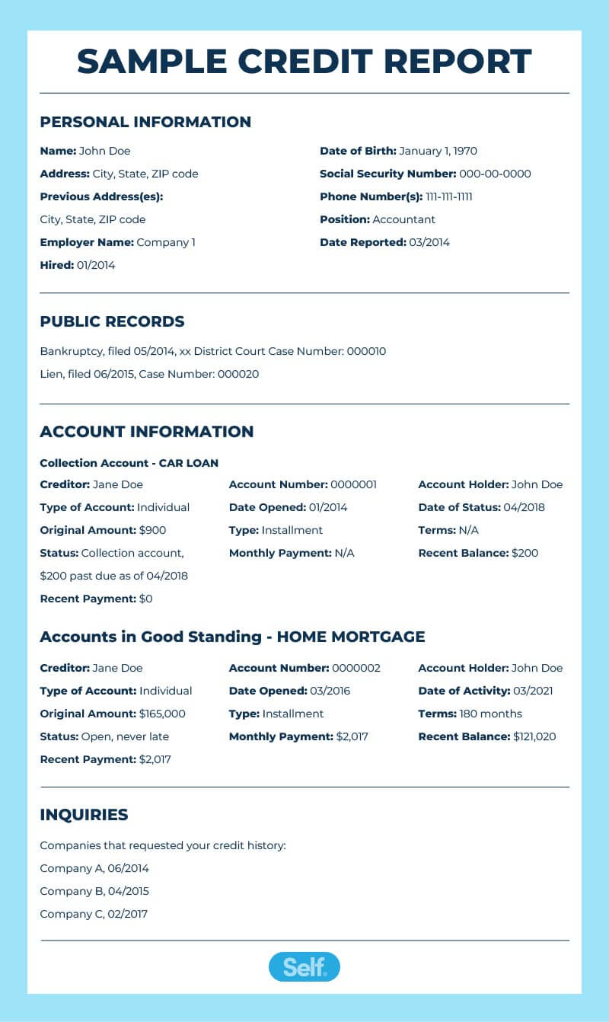
Sample Credit Report
Notes:
SHOW SLIDE 6-22: Sample Credit Report
Instructor Note: Point out the areas of the credit report and how each of these areas can allow or deny the applicant credit.

Slide 23
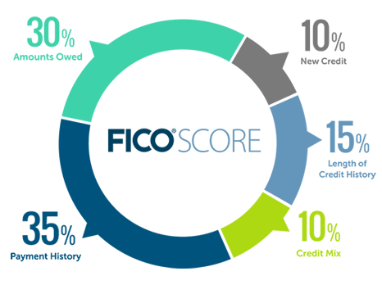
Five
Credit Score
Components
Notes:
SHOW SLIDE 6-23: 5 Components of a Credit Score
Credit Scoring System. Creditors use the credit scoring system to determine whether or not you are a good credit risk. Points are awarded for each factor that predicts reliability for debt repayment. Each of the 3 major credit bureaus (Equifax, Experian & Trans Union) uses a different variation of the Classic FICO (Fair, Isaacs, and Company) formula.
NOTE: The differences between each of the credit bureaus' credit scores and the Classic FICO formula are miniscule, and they all basically share the same formula/algorithm. One difference between FICO and Beacon scores is the scale. Classic FICO runs from 300–850, while Beacon Credit Score runs from 350–850. For this reason, your Equifax Beacon score will not be the same as your score from Experian or Trans Union.
Five Components:
Amount Owed (Utilization) – How much a person owes relative to their credit limits
New Credit – Whether there are new requests for credit/credit inquiries on the account
Credit Mix – Whether there is a mix of different types of credit, such as a mortgage, credit card, and/or installment loan
Payment History – Whether payments are made on time
Length of Credit History – How long an account has been open and how recently it has been utilized
A credit score is a three-digit number that originates from information in a person’s credit report. There are five components: payment history, credit utilization, length of credit history, credit mix, and new credit. There are several different types of credit scores that lenders may examine, but the most common one is the FICO score, which ranges from 300 to 850. The higher the score, the better.

Slide 24
What’s a Good Credit Score?
Score | Rating
750 and Higher | Excellent
749 - 700 | Very Good
699 - 650 | Good
649 - 600 | Fair
599 and below | Poor
Notes:
SHOW SLIDE 6-24: What’s a Good Credit Score
Look beyond the number
Many service members believe they know their credit score, but numbers can be deceiving. Not only are there several different types of credit scores, but the free scores provided by a bank, credit card or website often aren’t the same scores that lenders typically use.
The other issue is that focusing on the number alone can be misleading. It’s important to see a score in the context of the entire credit report. Consumers should pull their credit reports at least once a year to check for errors or fraud.
Under the Fair Credit Reporting Act , consumers may pull one free credit report from each bureau per year for a total of three reports. A strategy for keeping on top of things is to spread the requests throughout the year, getting one from each agency in turn.
Consumers should pull reports from only the official website, AnnualCreditReport.com . Beware of imposter sites. Once they receive their credit report, they can purchase their credit score from the site for a small fee. Military members can go to their installation’s personal financial manager or personal financial counselor for information on obtaining their credit score.
Many companies offer credit scores for sale alone or as part of a package of products. There are multiple credit scores available–you may have heard of a FICO score or a Vantage score. The Fair Isaac Corporation (FICO) score is the most popular credit-scoring model. Some banks and credit unions let customers monitor their credit score online.
Credit scores vary, depending on the product offered and the range of scores the creditor is using, so a “good” score is a slightly subjective term. In general, it takes five to seven years of good credit history to build up to a higher credit score. New credit users generally do not have high scores merely because they are new users. However, for FICO scores, the following is true but can change depending on other influences on other economic factors:
750 and higher: Considered excellent. People in this range will get the best credit rates.
700 to 749: Considered very good credit. Individuals may or may not qualify for the very best interest rates and terms, depending on what they are applying for.
650 to 699: Considered good credit. Individuals may still qualify for a loan but will pay more for credit than those in the excellent or good ranges
600 to 649: Considered fair credit. These individuals may find it difficult to get credit and will likely end up paying high interest rates.
599 and below: Considered poor credit. These individuals usually have some negative activity or adverse action on their report, such as foreclosures, liens, and/or credit judgments. Individuals in this category will probably have to pay the maximum interest rates allowed by law, if given credit at all.

Slide 25
The Cost of Credit
Borrower’s Credit Worthiness
The Lender
The Amount Borrowed
The Repayment Period
Notes:
SHOW SLIDE 6-25: The Cost of Credit
The Cost of Credit
Explain that while a borrower’s creditworthiness is a factor in determining the cost of credit, there are others, including:
The lender:
Potential employers accessing your credit report as a character check.
Potential landlords,
Mortgage companies,
Banks and other lending institutions,
Merchants offering charge accounts and credit cards
When reviewing this information, warn learners to avoid predatory lenders. Explain that when their own bank or credit union denies them credit, it should be considered a warning sign of poor creditworthiness. The situation will not be improved by getting involved with a predatory lender. Additional information on predatory lending appears in another section.
The amount borrowed: The larger the amount that is borrowed, the higher the total cost
The repayment period: Borrowing for a longer period may lower monthly payments but results in a higher total interest cost.

Slide 26
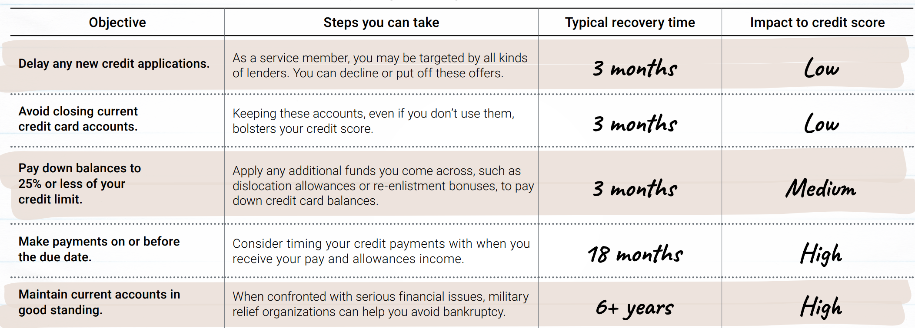
Increase Your Credit Score
Notes:
SHOW SLIDE 6-26: Increase Your Credit Score
Ensuring Accurate Reports. Approximately 20% of all credit reports contain inaccurate information. It's up to you to ensure erroneous information is corrected, or that the most updated information is included in your file.
Follow these steps to ensure your credit report is accurate:
Get Copies. The first step you must take is to get copies of all your credit reports. As discussed earlier, The Fair Credit Reporting Act (FCRA) requires each of the 3 nationwide credit reporting companies — Equifax, Experian, and TransUnion — to provide you with a free copy of your credit report, at your request, once every 12 months. The three nationwide credit reporting companies have a central website, a toll-free telephone number, and a mailing address through which you can order your free annual report. To order, visit annualcreditreport.com, call 1-877-322-8228, or go to http://www.consumer.ftc.gov/articles/0155-free-credit-reports and download the free Annual Credit Report Request Form and mail it to: Annual Credit Report Request Service, P.O. Box 105281, Atlanta, GA 30348-5281.
Note: Do not contact the three nationwide credit reporting companies individually. They are providing free annual credit reports only by requests submitted through the contact information provided. You may order your reports from each of the three nationwide credit reporting companies at the same time, or you can order your report from each of the companies one at a time.
Disputed Items. If you dispute an item on your report, by law, the credit bureau must investigate it, and if it is found to be incorrect, they must correct it. If they do not complete the investigation within 30 days, they must drop the disputed item from your report.
Your version. If the information in your report is accurate, you have the right to have a statement of your version of what happened included in your report. The credit bureau must send a copy of it to anyone who received a copy of your report in the past 6 months. If the information is confirmed, however, it becomes very difficult to remove;
(4) Pay your bills on time each month. Your payment history counts for about a third of your credit history, so make sure you pay your bills on time. One late payment can mean a big drop in your credit score. Set up online alerts or mark your calendar so you don't let a due date slip by. You can set up automatic payments from your bank account to help you pay on time, but be sure you have enough money in your account to avoid overdraft fees.
(5) Learn the legal steps to take to improve your credit report. You can find information regarding disputing errors on your credit report, tips on dealing with debt, and more by visiting The Federal Trade Commission at https://www.ftc.gov/. www.credit.com also has information on how to dispute errors.
(6) Beware of credit-repair scams. Sometimes doing it yourself is the best way to repair your credit. The Federal Trade Commission's “Credit Repair: How to Help Yourself” explains how you can improve your creditworthiness and lists legitimate resources for low-cost or no-cost help.
Note: There are no quick "fixes" available for a bad credit record, credit repair takes time!
Set up an appointment with a PFM/PFC at your local center to review your credit options.

Slide 27
Credit Misconceptions – Fact or Fiction?
1. You should carry a balance on a credit card to maintain your credit score.
FICTION
2. Old credit cards that aren’t in use should be cancelled.
FICTION
3. Pulling my credit report will affect my credit score.
FICTION
Notes:
SHOW SLIDE 6-27: Credit Misconceptions: Fact or Fiction?
1. FICTION: Some people believe they must carry a balance on their credit card to maintain their score. This is not true at all. In fact, paying off a credit card in full each month is responsible credit usage and keeps credit utilization low.
2. FICTION: Another common misconception is that old credit cards, perhaps store accounts that are no longer in use, should be cancelled. Canceling one’s oldest credit card accounts effectively shortens credit history, and that can actually have a negative impact on a credit score.
Closing credit cards also reduces available credit, which can make credit scores drop. Note, though, that if a person cannot responsibly use credit, then closing the card is probably a better option than making late payments or missing payments.
3. FICTION: Some people are also afraid to pull their own credit reports, fearing it will affect their scores. When an individual pulls their own report, however, this is known as a “soft” pull and has absolutely no impact on credit score. Applying for credit, on the other hand, is a “hard” pull and, as previously mentioned, will cause a score to dip.

Slide 28

Dealing with Creditors
Stay in Contact
  Current address and phone number
    Be Honest
    Life is unpredictable
    Have a Plan
      Pay just your debts
Notes:
SHOW SLIDE 6-28: Dealing with Creditors:
Even though you are entitled to the legal protections we just discussed, there are both right ways and wrong ways to deal with creditors. If you should find yourself in financial difficulty, here are some positive actions you can take:
Stay in contact. Keep an open line of communication with your creditors and let them know if there is a problem. If a friend owed you money and was avoiding you or not returning your phone calls, you would think he or she was trying to “stiff ” you. Businesses are the same way. Don’t avoid the situation, just talk to them. Also, if you change your address or phone number, make sure to contact your creditors right away, so no attempts at communication fall through the cracks.
Be honest. Life doesn’t always go according to plan. Be upfront and honest with your creditors.
(3) Have a plan. Approach your creditors with a plan to of action to resolve your debt. Be careful of promising more than you can deliver.

Slide 29

Credit Repair Scams
“Erase your bad credit! 100% guaranteed!”
“Remove bankruptcies, judgments, liens, and bad loans from your credit file, FOREVER!”
“Create a new credit identity - Legally!”
No One can legally remove accurate information
Some Attempts Are Criminal Acts!
Time and responsible spending habits are the
only ways to erase bad credit
Notes:
SHOW SLIDE 6-29: Credit Repair Scams
Credit Repair clinics make many offers to miraculously erase negative information from your credit files. Not true. Only time, a deliberate effort, and a personal debt repayment plan will improve your credit.
Some credit repair schemes promise you that they can "hide" bad credit by helping you to establish a new credit identity.
If you pay a fee for such a service, the company may direct you to apply for an Employer Identification Number (EIN) from the Internal Revenue Service and will tell you to use the EIN in place of your social security number when you apply for credit.
You may also be instructed to use a new mailing address. This practice, known as file segregation, is a federal crime. You could face fines or even a prison sentence.

Slide 30
Credit Freeze and Alerts
Credit Freeze
Fraud Alert
Active-Duty Alert
Free Credit Monitoring
Visit www.consumer.ftc.gov for more information
Notes:
SHOW SLIDE 6-30: Credit Freeze and Alerts
Frequent moves and deployments can make identifying and addressing identity theft extra challenging for service members. Get a step ahead and take advantage of tools that safeguard your credit. Placing a credit freeze is one of the strongest ways to protect yourself from identity theft.
Also known as a security freeze, this free tool lets you restrict access to your credit report, which in turn makes it more difficult for identity thieves to open new accounts in your name. That’s because most creditors need to see your credit report before they approve a new account. If they can’t see your report, they may not extend the credit.
How does a credit freeze work?
Implement a no-cost credit freeze to keep identity thieves from opening fraudulent accounts.
• A credit freeze is the best tool to restrict access to your credit report.
» This makes it harder for identity thieves to open new accounts using your identification.
• Creditors need your credit information before they approve a new account.
» Because creditors cannot see your information during a credit freeze, they are not likely to extend new credit.
How do I initiate a credit freeze?
Contact each of the three nationwide credit bureaus: Equifax, Experian and TransUnion.
Provide your name, address, date of birth, Social Security number and other personal information.
Receive a unique PIN or password from each credit bureau.
Keep the PIN in a safe place. You will need it when you decide to lift the freeze.
A credit freeze does not affect your credit score.
A credit freeze also does not:
-prevent you from getting your free annual credit report
-keep you from opening a new account. But to open one, you'll need to lift the freeze temporarily. It's free to lift the freeze and free to place it again when you're done accessing your credit.
-keep you from applying for a job, renting an apartment, or buying insurance. The freeze doesn't apply to these actions so you don't need to lift it.
-prevent a thief from making charges to your existing accounts. You still need to monitor all bank, credit card and insurance statements for fraudulent transactions.
You can protect your children from identity theft, too. Place a no-cost credit freeze for children age 16 and under by contacting the three credit agencies.
Fraud Alert: is used to inform creditors that you may be a victim of fraud. A fraud alert can make it harder for an identity thief to open accounts in your name. The fraud alert requires creditors to verify that you are the person adding new credit accounts or changing limits on existing credit accounts by contacting you at a phone number you have provided.
Active-duty military alert - if you are in the military and want to minimize your risk of fraud or identity theft while you are deployed (duration 1 year but can be renewed for the length of your deployment. The credit bureaus will also take you off their marketing lists for pre-screened credit card offers for two years, unless you ask them not to.
A credit freeze locks down your credit. A fraud alert allows creditors to get a copy of your credit report as long as they take steps to verify your identity. You still need to monitor all bank, credit card and insurance statements for fraudulent transactions.
Visit www.consumer.ftc.gov

Slide 31
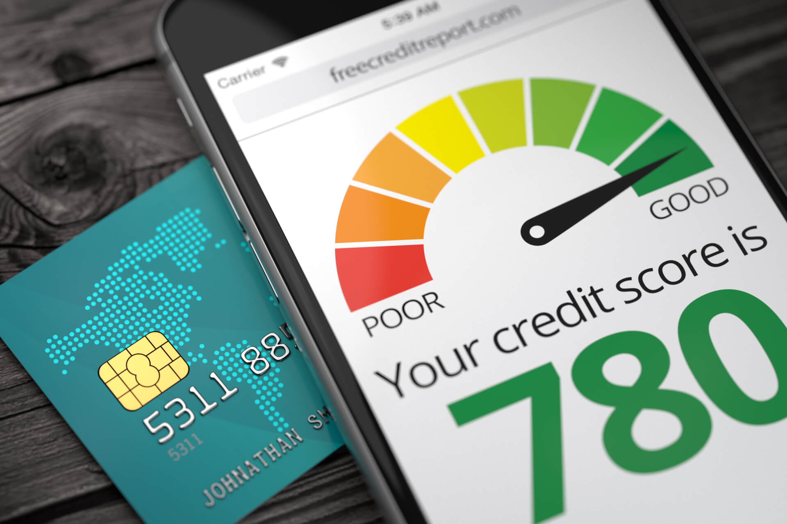
Summary and Action Items
Recognize and understand how to protect yourself from misleading consumer practices and report complaints.
Pull your free credit report
Monitor your credit score regularly and report any suspicious activity immediately
If you have debts, reach out to your creditors and be honest. This is the best way to resolve your problems and start the journey towards a better credit score
This Photo by Unknown Author is licensed under CC BY-ND
Notes:
SHOW SLIDE 6-31: Summary and Action Items
Credit is something you will use throughout your lifetime. It can be a valuable tool, or, it can be a source of long lasting difficulty. The availability and over extension of credit has contributed significantly to the rise in personal bankruptcy rates in the past 20 years.
Wise use of credit can be a key element in achieving financial independence, while misuse can be a ticket to financial ruin.
To help you make wise credit decisions, we have discussed factors that affect the cost of credit, appropriate and inappropriate uses of credit, and warning signs of too much debt.
We also discussed what credit reports are and steps you should take to ensure yours is accurate and reflects favorably on your ability to manage your finances.
Lastly, we identified sources of help should you encounter problems properly using credit.

Slide 32

Sources of Assistance
Chain of Command
Financialfrontline.org
Army Community Service (ACS)
Army Emergency Relief (AER)
Armed Forces Disciplinary Control Board
Legal services
Better Business Bureau (BBB)
Consumer Financial Protection Bureau (CFPB)
Federal Trade Commission (FTC)
Militaryconsumer.gov
Military OneSource
Notes:
SHOW SLIDE 6-32: Sources of Assistance
SUMMARY
Throughout this course we will emphasize that you, as members of the military, have a wide range of assistance available to you absolutely free of charge. Among these are the Army Community Service Center and Army Emergency Relief. Rely on these sources for help.

Slide 33

Questions?
Notes:
SHOW SLIDE 6-33: Questions
Take this time to answer any questions the Soldiers may have. Then, proceed to the Check on Learning

Slide 34
Question #1
Where can you go to get your free credit report?
One of the major credit bureaus
AnnualCreditReport.Com
Amy Community Service
All the Above
D. All the Above
Notes:
SHOW SLIDE 6-34: Check on Learning #1
NOTE: Click enter for the answer to appear on slide.
Question: Where can you go to get your free credit report?
Answer: D. All of the Above

Slide 35
Question #2
Which information from your credit report might be a warning of identity theft?
New account listed you do not remember opening
Several 30-day delinquencies on accounts for which you made late payments
Soft inquiries from prospective employers that did not offer you a job interview
Accounts described as open that you are unsure if you closed
New account listed that you do not remember opening
Notes:
SHOW SLIDE 6-35: Check on Learning #2
Question: Which information from your credit report might be a warning of identity theft?
New account listed you do not remember opening
Several 30-day delinquencies on accounts for which you made late payments
Soft inquiries from prospective employers that did not offer you a job interview
Accounts described as open that you are unsure if you closed
Answer: A. New account listed you do not remember opening

Slide 36
Question #3
True or False:
You will have lower monthly payments with a long-term loan
TRUE
Notes:
SHOW SLIDE 6-36: Check on Learning #3
NOTE: Click enter for the answer to appear on slide.
Question: True of False. You will have lower monthly payments with a long-term loan.
Answer: True

Slide 37
Question #4
Under the Truth in Lending Act, what is one thing a lender MUST disclose to you when you apply for a loan?
Annual Percentage Rate
Warranty Information
Payment Start Date
Lender’s Name and Address
A. Annual Percentage Rate
Notes:
SHOW SLIDE 6-37: Check on Learning #4
NOTE: Click enter for the answer to appear on slide.
Question: True of False. You will have lower monthly payments with a long-term loan.
Answer: True

Slide 38

End of Lesson Six!
Notes:
SHOW SLIDE 6-38: End of Lesson 6
At this time, give the students a break if necessary. Then, proceed to Lesson 7.

