Slide 1
Lesson 5:
Financial
Services
Notes:
Learning Activity 5: Financial Services
Length of Instruction: (30 MINUTES)
Method of Instruction: Classroom/Discussion
Instructor to Student Ratio: 1:25
Time of Instruction: 30 Min
Media: Large Group Instruction
Required Student Materials:
Student Booklet
Writing Utensil
INTRODUCTION: During this learning activity, we will discuss the importance of managing a checking account and how to navigate the online services available to streamline the management of one’s finances.
We will explore the difference between the financial institutions, look at online banking, understand the difference between debit and credit cards, look at the costs of financial services, and provide a brief overview of how to write a check.

Slide 2
Comparing Banks and Credit Unions
Key Differences:
FDIC: Federal Deposit Insurance Corporation
https://www.fdic.gov/
NCUA: National Credit Union Administration
https://ncua.gov/
BANKS
For-profit
Anyone can be a customer
Higher fees and interest rates on loans
Diverse array of product offerings
Cookie-cutter services
Deposit insurance provided by FDIC
CREDIT UNIONS
Non-profit
Must qualify for membership
Lower fees and better interest rates
May have limited product offerings
More personalized customer service
Deposit insurance provided by NCUA
Notes:
SHOW SLIDE 5-2: Comparing Banks and Credit Unions
Referring to the slide, explain that although banks are for-profit companies and credit unions are non-profit organizations, that distinction probably does not affect customer experience. There are also other factors, such as fees and interest rates and product offerings that should be considered when deciding whether to open an account with either a bank or a credit union.
The decision to open an account in a bank or a credit union is a personal and pragmatic one, and type of institution can meet the financial needs of service members. Remind the students that as Servicemembers, they do meet the requirements for memberships at credit unions.
FDIC: https://www.fdic.gov/
NCUA: https://ncua.gov/

Slide 3
Types of Accounts Offered
Checking Account
(called a “share draft” by Credit Unions)
Savings Account
(called “share savings” by Credit Unions)
Notes:
SHOW SLIDE 5-3: Types of Accounts Offered
Explain that although banks and credit unions offer many account and service options, most people generally start by opening a savings account, a checking account, or both.
Savings Accounts
Explain that a savings account (called a “share savings” account by credit unions) provides a safe place for money that may need to be tapped from time to time to cover unusual expenses while earning interest on the account balance.
Checking Accounts
Explain that checking accounts (called a “share draft” account by credit unions) are more flexible, typically allowing unlimited deposits and numerous withdrawals. In addition to writing physical checks, checking accounts can be used to authorize electronic checks or to pay bills through online services. Note that most people withdraw money from checking accounts by using an automatic teller machine (ATM) card or debit card.

Slide 4
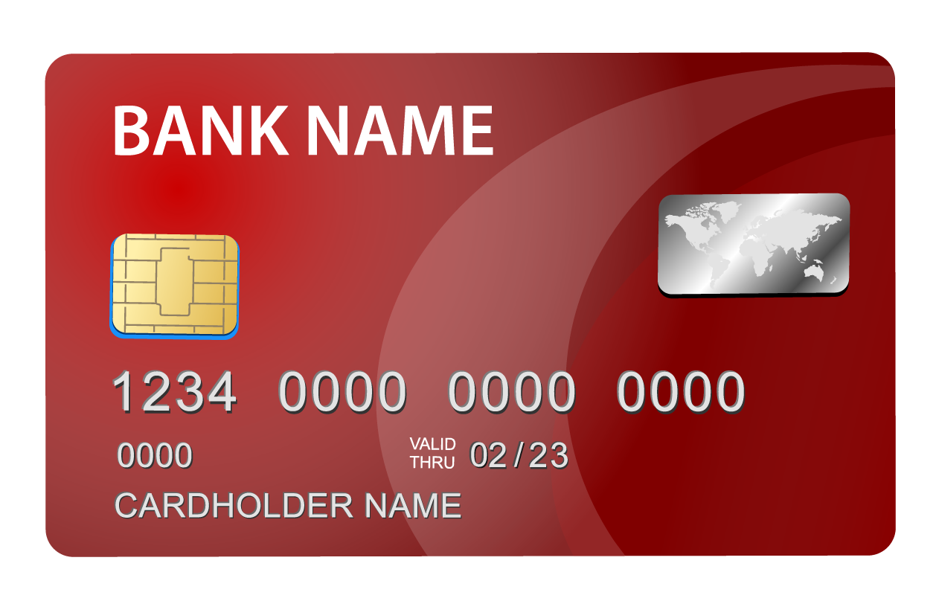
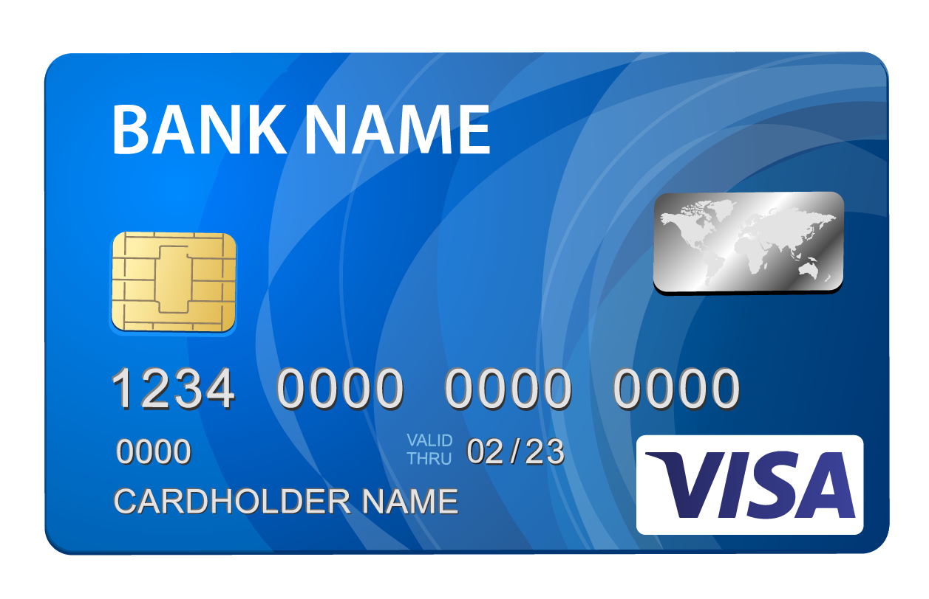
ATM and Debit Cards
ATM Cards
Debit Cards
Cannot make purchases
Can make purchases
Notes:
SHOW SLIDE 5-4: ATM and Debit Cards
ATM cards: These are PIN based cards that allow account holders to make transactions at their financial institution’s (or partner institutions') ATMs. Customers can withdraw cash, make deposits, or transfer funds between accounts. ATM cards cannot be used to make purchases.
Debit Cards: Most financial institutions offer debit card that does everything an ATM card can do, and more. The debit card looks like a credit card, complete with a chip and a Visa or Mastercard logo but is linked to a checking account. When the debit card is used, the user enters a PIN and funds are transferred immediately to the merchant account or issued as cash. Debit cards are much more multi-functional than an ATM card.

Slide 5
Debit Cards: An Overview
What is a Debit Card?
Issued by your bank
Linked to your bank account
Where can Debit Cards be used?
Any stores or locations that take major credit cards (Visa, Mastercard)
Online – but shop with caution!
Why use a Debit Card?
Purchase without using cash
Immediate money transfer
What if I use all the money in my Checking Account?
Avoid this by checking your statement regularly
Create and follow a budget to avoid overspending
Utilize overdraft protection
What is a PIN?
Personal Identification Number (PIN)
Remember it, but don’t share it!
Where to track your Debit Card spending?
Check your online bank statement
You will also receive a paper statement monthly unless you choose “paperless billing”
A great tool to help you manage your personal finances, optimize spending, and grow savings efficiently is available at www.pocketguard.com
Notes:
SHOW SLIDE 5-5: Debit Cards
What is a debit card?
A debit card is a card that is issued by a bank allowing the holder to make transactions that pull the necessary funds from the holder’s account immediately.
NOTE: Sometimes a debit card is free to use. Sometimes you will pay a fee to use the card.
Why use a debit card?
Debit cards let you buy things without carrying cash. You can use your debit card in most stores to pay for something. You just swipe the card and enter your PIN number on a keypad.
Debit cards take money out of your checking account immediately. Therefore, you will know immediately how much money is left in your account.
Debit cards let you get cash quickly. You can use your debit card at an automated teller machine, or ATM, to get money from your checking account. You also can get cash back when you use a debit card to buy something at a store.
What is a PIN?
A “PIN” is a security code that belongs to you. PIN stands for personal identification number. A bank or credit union gives you a PIN when you get a debit card. You can change your PIN to a number you will remember.
When you use your debit card, you need to enter your PIN on a keypad. This is one way the bank tries to stop dishonest people from using your debit card to get your money. NEVER share your PIN with anyone. Remember it. Do not keep it in your wallet or on your card.
How do debit cards work?
When you open a checking account at a bank or credit union, you usually get a debit card. A debit card lets you spend money from your checking account without writing a check.
You can use your debit card to buy things in a store or online
You can use it at an ATM to get cash
When you pay with a debit card, the money comes out of your checking account immediately. There is no bill to pay later.
How do I know where I used my debit card? When you open a checking account, you also have the ability to set up online banking (which we will discuss in more detail later). A debit card takes the money from your account immediately, so the fastest way to know where your debit card was used is to login to your online account and check your statement summary. Your statement is also a great way to help you track your spending and create a budget.
What if I use all the money in my checking account?
You might not have enough money in your checking account. That means your debit card will be “declined.” Some banks and credit unions might let you sign up for “overdraft protection.” That means you can use your debit card even when you do not have enough money to pay for the things you are buying, but you might have to pay a fee to the bank. Some banks might charge this fee for every purchase until you put enough money in your account to pay for the things you are buying. Utilize your online banking account to keep track of your spending by checking it regularly and ensure that you do not overspend!

Slide 6
Debit Cards vs. Credit Cards
Debit Cards | Credit Cards
Linked to a personal bank account | Linked to a financial institution that issued the card
Money withdrawn immediately | Institution pays merchant, you now owe the institution
Used to withdraw funds from ATM’s | Often requires annual fees to use
Spending limit depends on the amount of money available in your account | Issuer sets the credit limit
No interest charge because no money is borrowed | If bill is not paid in full, interest is charged on outstanding balance
Notes:
SHOW SLIDE 5-6: Debit Cards vs. Credit Cards
How is a debit card different from a credit card?
When you buy something with a credit card, you are borrowing money from the credit card company. The credit card company will send you a bill every month for the money you borrowed to buy things.
When you use a debit card, you are using money in your checking account to buy things.
Debit Cards:
You can get a debit card from the bank when you open a checking account
Money comes out of your checking account when you pay with a debit card
You don’t pay extra money in interest when you pay with a debit card
You can use a debit card at an ATM to get money from your checking account
You do not build a credit history using a debit card
You might have a problem with something you buy online. It is easier to get your money back if you use a credit card.
Someone might steal your debit card number online. The thief can take all your money out of your bank account.
Track transactions on register, online, or in an app.
Credit Cards:
You apply for a credit card at a bank or store
You get a bill once a month for everything you buy with a credit card
You might pay extra money in interest if you don’t pay all of your credit card bill every month
You can use a credit card as a safer way to pay for things online
You can build a credit history using a credit card if you pay the whole bill every month when it is due
Someone might steal your credit card number online. The law says you can lose only $50 if you report it right away.

Slide 7
Safety and Protection
Sign the back of your card
1
Memorize PIN and don’t share it
2
Be wary when using ATM’s
3
Watch out for “shoulder surfers”
4
Be aware of any phony card readers and video surveillance
5
Notes:
SHOW SLIDE 5-7: Safety and Protection
Remind learners that bank cards are convenient for paying for purchases but may expose users to loss or fraudulent transactions.
Liability (what you are responsible for paying) for a lost or stolen card is $50 as long as the cardholder notifies the bank within two days of discovering fraud, but the liability increases up to $500 if more than two days pass.
To protect themselves at an ATM, cardholders should:
Sign the back of their card as soon as it is received.
Memorize the PIN and not share it. No one should write their PIN on their card or keep the number in their wallet.
Limit ATM use to machines that are well-lit and locations that are clearly visible from the street or from foot traffic.
Watch out for “shoulder surfers.” Cardholders should cover the keypad with their free hand as they enter their PIN.
Be aware of any loose or odd-looking card readers at the ATM, or even at gas pumps, that might indicate card skimming or unauthorized video surveillance. Identity thieves use skimming readers to capture account data stored in the magnetic strip of the card.
Remind learners that Soldiers preparing for deployment should take extra precautions to ensure they protect their finances while serving overseas.
Many banks and credit card companies have fraud-monitoring systems that may interpret unusual activity—like someone using a card in a new location—as fraud. Setting a travel notice before departure lets the bank or credit card company know that the account-holder in control of their cards, so they can use them worry free. Cardholders should notify their bank via phone or their online account.

Slide 8
Instant account access
Online bill-pay
Money transfers
Mobile deposit of checks
Automatic bill pay
Paperless statements
Online Banking Services:
Notes:
SHOW SLIDE 5-8: Online Banking
Online banking is has become a very common way for individuals to manage their finances.
Some services offered through online banking:
Access to accounts and transaction history
Paying bills online
Transferring money between accounts
Deposit checks by scanning checks
Automatic payments
Paperless statements
Many people use online banking to effectively monitor their financial transactions and even link their accounts with financial software that helps them with budgeting.
Many banks/credit unions also have alerts for fraudulent activity. Ask your banking institution if they do.
Remember, always safeguard your username and password. If someone were to gain access of this information, it could have a devastating effect on your finances.

Slide 9
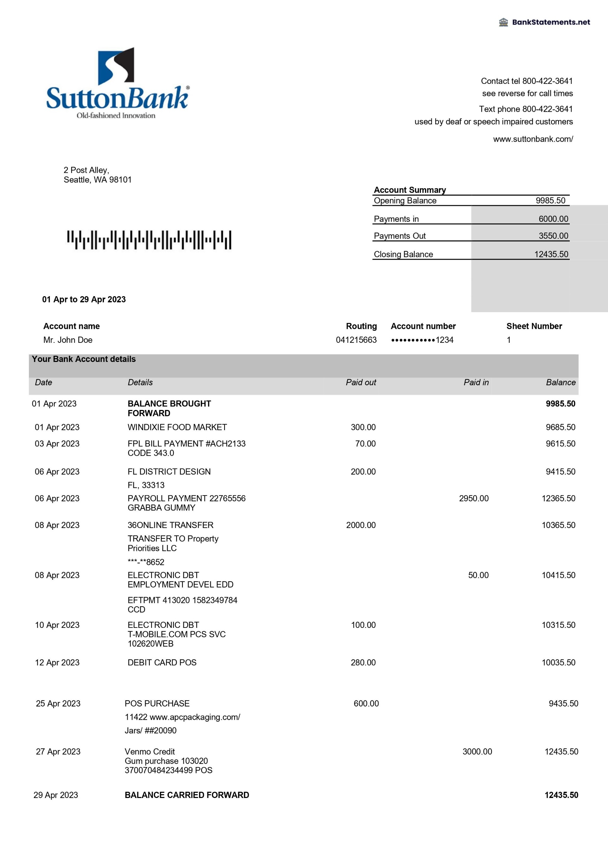
Snapshot of your financial activity
Summarizes account transactions from the statement period
Deposits
Withdrawals
Account transfers
Traditional banks, online banks, and credit unions all send bank statements
You have the option to enroll in paperless billing and stop receiving statements in the mail
Bank
Statements
Notes:
SHOW SLIDE 5-9: Bank Statements
A bank statement is a summary of financial transactions that occurred at a certain institution during a specific time period. For example, a typical bank statement may show your deposits and withdrawals for a certain month.
Online banking has made it easy to see transactions. However, they may not show up in real-time; transactions may take a few days to show in your history. For any major transactions, keep receipts until the transaction hits your account to ensure you are tracking your paid in versus paid out. The bank statement is another tool that can help you stick with your spending plan and stay within your budget.
Make sure to go through your bank statement and online transactions on a regular basis to spot any suspecting purchases may have been charged. It could be a sign of identity theft.
By regularly reviewing your statements, you can also spot any banking errors so that you can get them corrected quickly.

Slide 10
Service/maintenance fees
Usage fees
ATM fees
Foreign transaction fees
Online bill-pay fees
Check-writing fees
Overdraft charges
Stop-payment fees
Statement fees
Research fees
Account-closing fee
Check printing
Safe-deposit box rental
Other costs and fees
Costs of Financial Services:
Notes:
SHOW SLIDE 5-10: Cost of Financial Services
Learners may wish to consider if they need to change their bank or credit union. The extent of the institution's ATM network and fees associated with using it outside the U.S. are especially pertinent to the military lifestyle.
Ways to avoid banking fees:
Use ATMs that are associated with your bank to avoid fees.
Monitor your online banking to check for errors that might cause unnecessary fees.
Make sure that you have enough money in your account to avoid expensive overdraft and non-sufficient fund fees. These can add up!

Slide 11
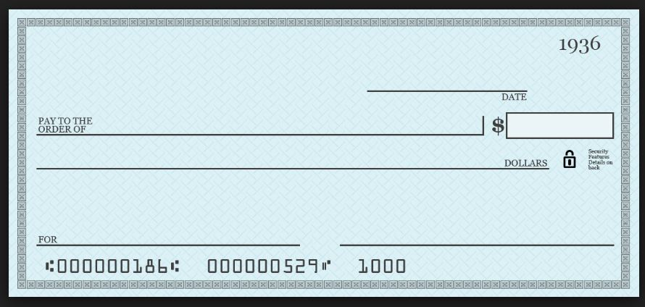
Writing a Personal Check
#1
#4
#2
01/01/20XX
Verizon Wireless
100.58
One hundred dollars and 58/100 ---------------
January Phone Bill
Your Signature
#3
#5
#6
Notes:
SHOW SLIDE 5-11: Writing a Personal Check
Most transactions you perform with your checking account can be accomplished with a debit or ATM card. However, some transactions, such as paying rent or utility bills may require you to write a check.
First, determine the amount for the check, verify that your current account balance is enough to cover the amount of the check and any check fees, and obtain the next available blank check.
#1: Write the current date on the check
#2: Write the full name of the payee (the person or company to whom you are writing the check)
#3: Write the money amount on the check, using figures
#4: Write the same money amount in longhand, this time using words; include both dollars and cents. Cents are written as “XX/100” Make sure to begin writing as far to the left as possible on this line and then draw a line after the written money amount extending to the preprinted word “Dollars.”
NOTE: Explain that this action is necessary for security to prevent someone else from altering the amount.
#5: Although not required, it is good practice to write a short description or key word representing the transaction in the MEMO space
#6: Sign the check. This signature should match the one you used when you opened the account

Slide 12
Web Resources
Resource | Website
myPay Login | https://mypay.dfas.mil/#/
Military OneSource – How to Open a Bank Account and an Introduction to TSP | https://www.militaryonesource.mil/military-basics/new-to-the-military/military-pay-101-how-to-open-a-bank-account-and-tsp-introduction/
DFAS – Information on Updating your Bank Account Information | https://www.dfas.mil/retiredmilitary/newsevents/news/bankchanges/
Financial Frontline | www.financialfrontline.org
Notes:
SHOW SLIDE 5-12: Web Resources
Inform the students that all of these links will also be available on the PFMC website. The link for this site is www.pfmcstudentportal.com. It is also listed in their Student Booklet they received at the beginning of class.

Slide 13
Sources of Assistance
Chain of Command
Army Community Service (ACS)
Army Emergency Relief (AER)
Armed Forces Disciplinary Control Board
Legal Services
Better Business Bureau (BBB)
Consumer Financial Protection Bureau (CFPB)
Federal Trade Commission (FTC)
Notes:
SHOW SLIDE 5-13: Sources of Assistance
Additional Sources of Assistance available to Servicemembers.

Slide 14
Any Questions?
Notes:
SHOW SLIDE 5-14: Questions

Slide 15
Any Questions?
Check on Learning
Notes:
SHOW SLIDE 5-15: Check on Learning
NOTE: Conduct a check on learning and summarize the learning activity.

Slide 16
Any Questions?
True or False:
A Credit Union is a for-profit institution
Question
#1
FALSE
Notes:
SHOW SLIDE 5-16: Question #1:
Answer: False. A BANK is a for-profit institution

Slide 17
Any Questions?
Which of the following are a costs that can sometimes be associated with financial services?
Overdraft fees
Foreign Transaction Fees
ATM Usage Fees
All the Above
Question
#2
D. All the Above
Notes:
SHOW SLIDE 5-17: Question #2:
Answer: False. A BANK is a for-profit institution

Slide 18
Any Questions?
Which of the following is NOT a characteristic of a debit card?
Money is taken out immediately
No interest charge because no money is borrowed
Institution pays the merchant, then you owe the institution
Used to withdraw funds from ATM’s
Question
#3
C. Institution pays the merchant, then you owe the institution
Notes:
SHOW SLIDE 5-18: Question #3:
Answer: False. C. Institution pays the merchant, then you owe the institution

Slide 19
Any Questions?
End of Lesson 5!
Notes:
SHOW SLIDE 5-19: End of Lesson 5
At this time, provide the students with a 5–10-minute break if needed. If not, continue to Lesson 6, Consumer Awareness

